Slide 1
Tips & Tricks for Thriving in Your First Management Position
Ashley Durkee and Brent Husher
Missouri Library Association Conference 2016
Notes:
notes

Slide 2
About Mid-Continent Public Library
Largest library system in Kansas City metropolitan area
Serves population of 770,000
Service area over 3 counties
Includes 36 service outlets

Slide 3
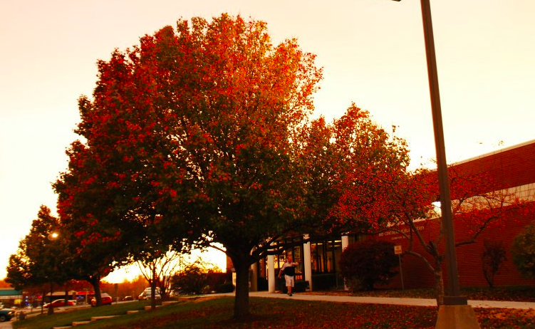
About Our Branch: Grandview, MO
Community we serve
Population & income
School district
Demographics
Staff upon arrival
Caring & committed
Micromanaged
Decision Making

Slide 4
Tips & Tricks: Round 1
Step 1: Observe, listen, & learn
Step 2: Develop shared vision
Step 3: Build team environment
Step 4: Experiment with innovation

Slide 5
Tips & Tricks: Round 2
Step 5: Focus on impact
Step 6: Model behavior
Step 7: Accountability & transparency
Step 8: Communication

Slide 6
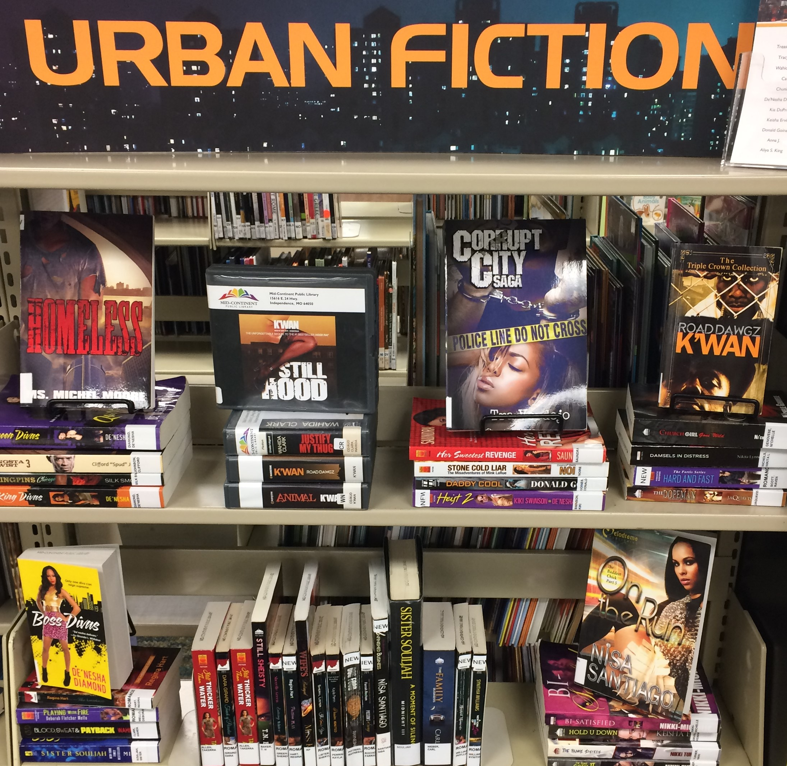
Case Studies
Teens
- Scheduling and physical space
- Advocacy and community relations
Increased access & diversity
- Windows & mirrors
- Hiring process

Slide 7
Your turn!
Questions?
Successes and/or failures of your own?
Ready for lunch?
Contact Information
Ashley Durkee
adurkee@mymcpl.org
Brent Husher
bhusher@mymcpl.org

