Slide 1
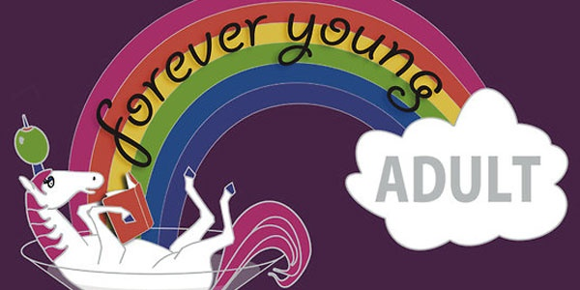
Jenny Ellis
Librarian
St. Joseph Public Library
jellis@sjplnow.com

Slide 2
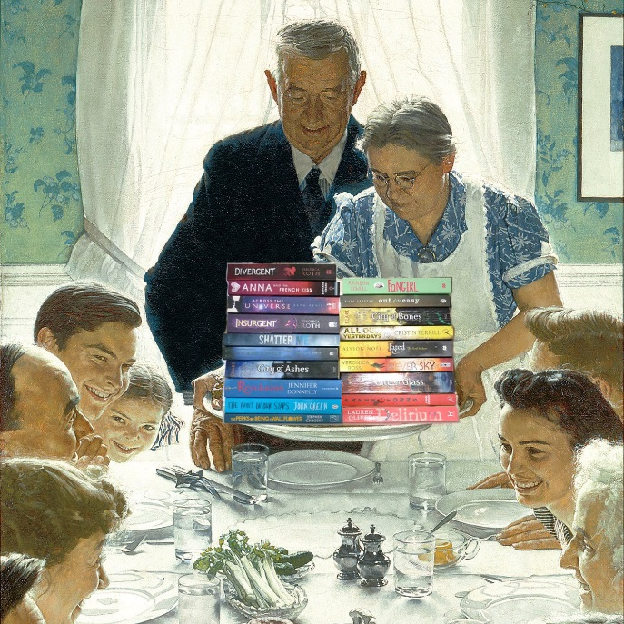
A site for YA readers who are a little less Y and a bit more A.
Created in 2009, Forever Young Adult is a community for YA fans who are a little less "Y" and a bit more "A." FYA is a place where you can let your inner Lady Nerd loose and swoon over fictional characters without shame (while sipping on a cocktail). From book reviews to TV crushes to movie drinking games, it's basically a non-stop internet slumber party, and you're totally invited!

Slide 4
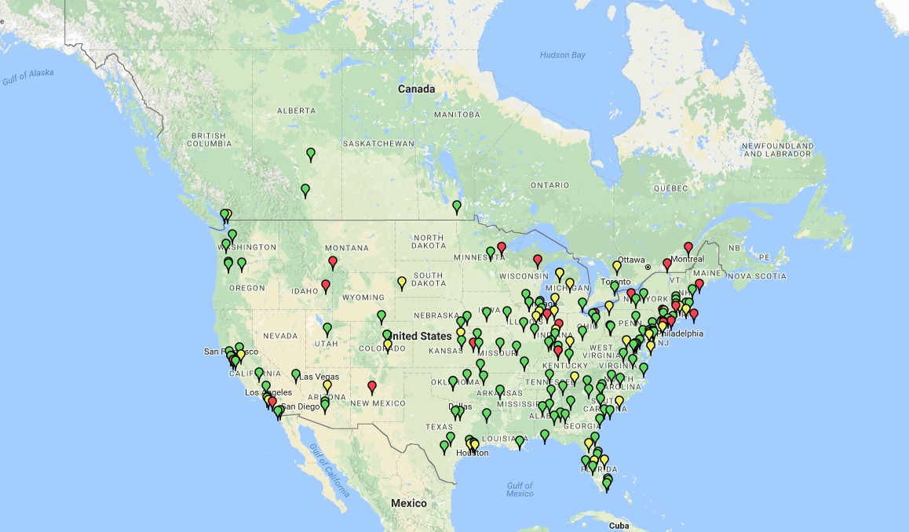

Slide 5
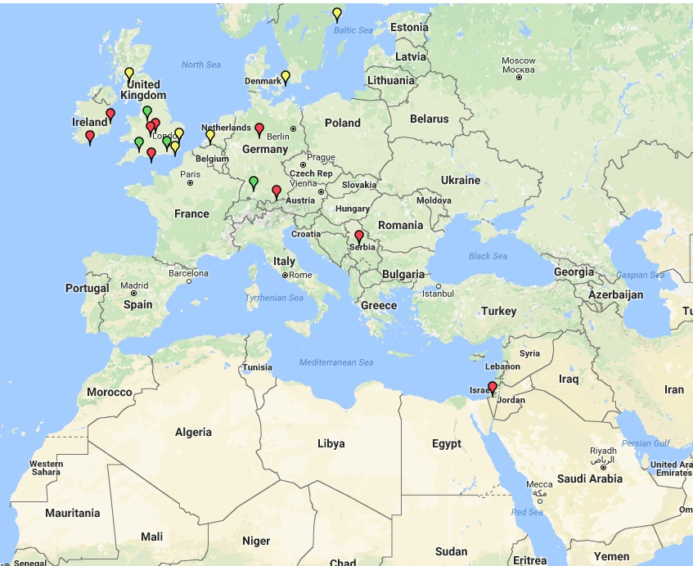

Slide 7
Sample discussion questions
ICE BREAKER Have you ever fallen for the girl/boy next door? or Who's your fave fictional girl/boy next door?
QUESTIONS 1. Do you ship Wattscroft? Or do you think Rachel and Mycroft were better as friends?
2. For someone as anti-social as Mycroft, did you find it strange that he knew so many people around the city?
3. Watts and Mycroft's guidance counselor poses a great question: "Does being an eccentric genius excuse any kind of behavior, no matter how antisocial or self-destructive?"

Slide 8
4. Rachel's parents are pretty typical YA parents, but Mike (her brother) is a more well-rounded character. Did you think he was a good brother?
5. Did you have any theories on who the killer was before the end?
6. How did you feel about the pacing of the mystery and its reveal?
7. How did you feel about the Sherlock Holmes parallels and references? How would you rank this book against other Sherlock Holmes adaptations? 8. There is a lot of Australian slang and terminology in the book.
- For non-Australian clubs: Did you find it distracting, or did it add to the "atmosphere" of the story?
- For Australian clubs: Did you find it authentic? What did you think of the depictions of the attitudes about urban and rural life, and Melbourne itself, if you're familiar with it?
9. EVERY BREATH is the first in a trilogy. Will you read the others? (Fair warning: the third book has yet to be picked up by a North American publisher.)

Slide 10
A tale of two groups….
I was a member Omaha-February 2011-August 2015
A good majority of the members are librarians at Omaha Public Library
I found them on the official FYA map and contacted them before I even moved to the area.
Founding member of St. Joseph-February 2016-present
Moved back to my hometown in late fall 2015. Kansas City has a chapter but they don’t have an active book discussion group so I started my own

Slide 11
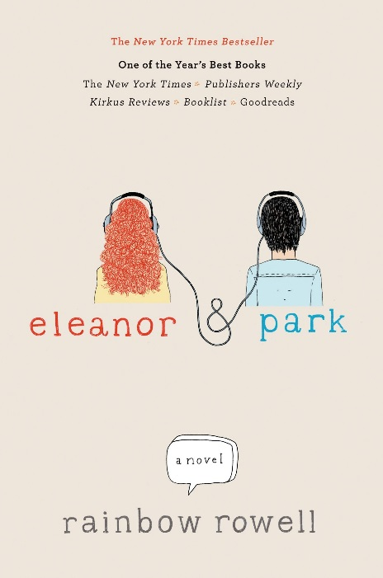
Omaha group met Rainbow Rowell!!!
Our book that month was:

Slide 12
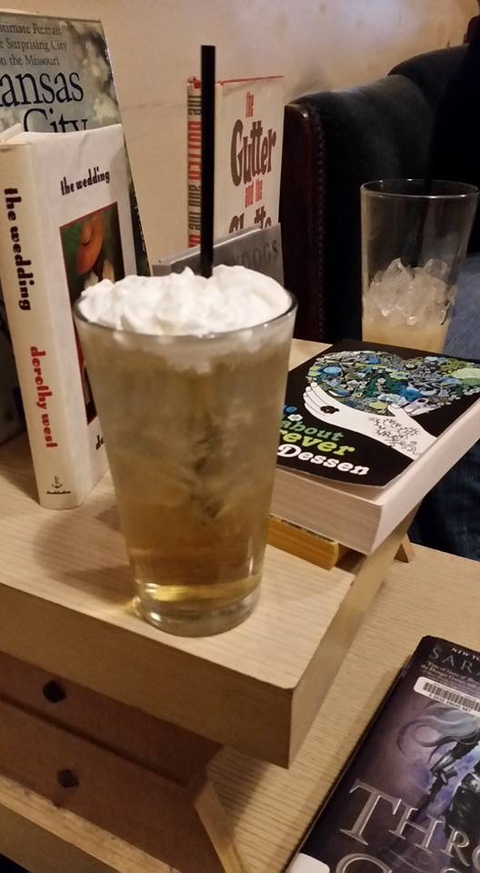
St. Joseph chapter
12 members in our facebook group.
Most we’ve had at a meeting is 7. Four members of our facebook group have never attended a meeting. I will only add people that live in our town.
Bar owner is a “member” but doesn’t participate in our discussions.
I did previously know all but 2 members of the discussion group. 1 person found us via the official website.

Slide 13
Where we meet: Tiger’s Den

Slide 14
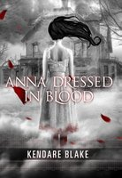
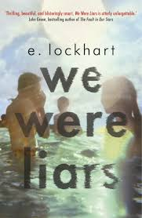
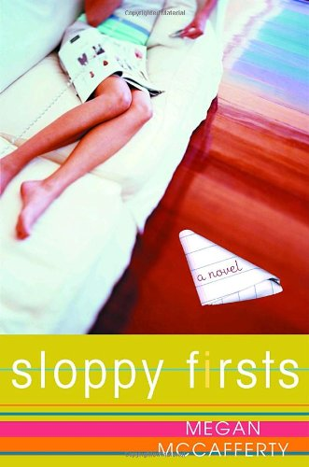
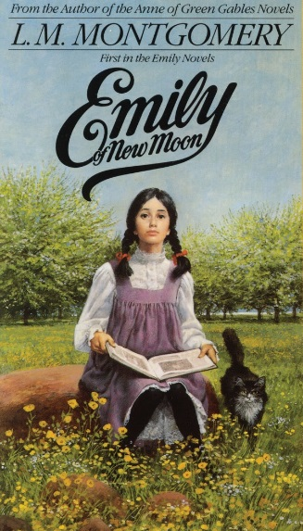
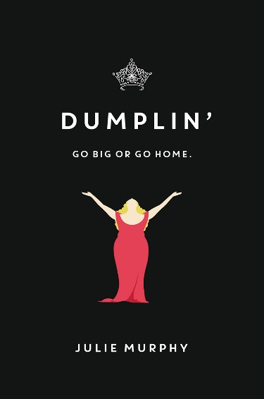
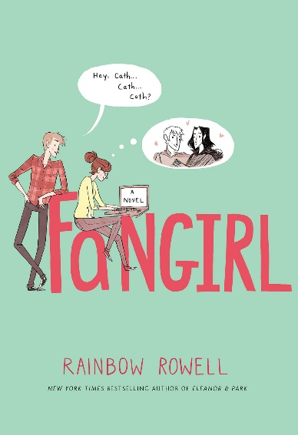
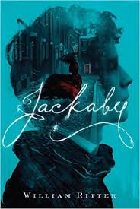
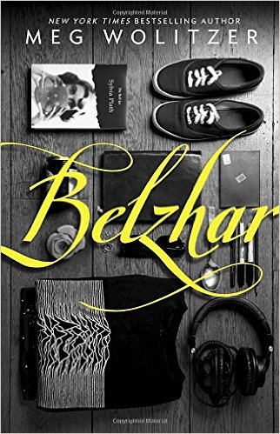
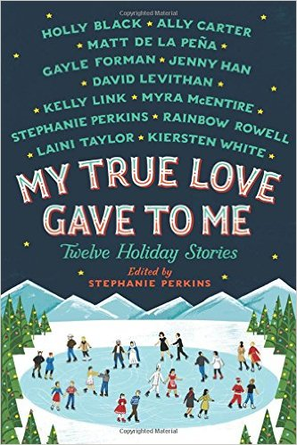
Some past book selections:

Slide 15
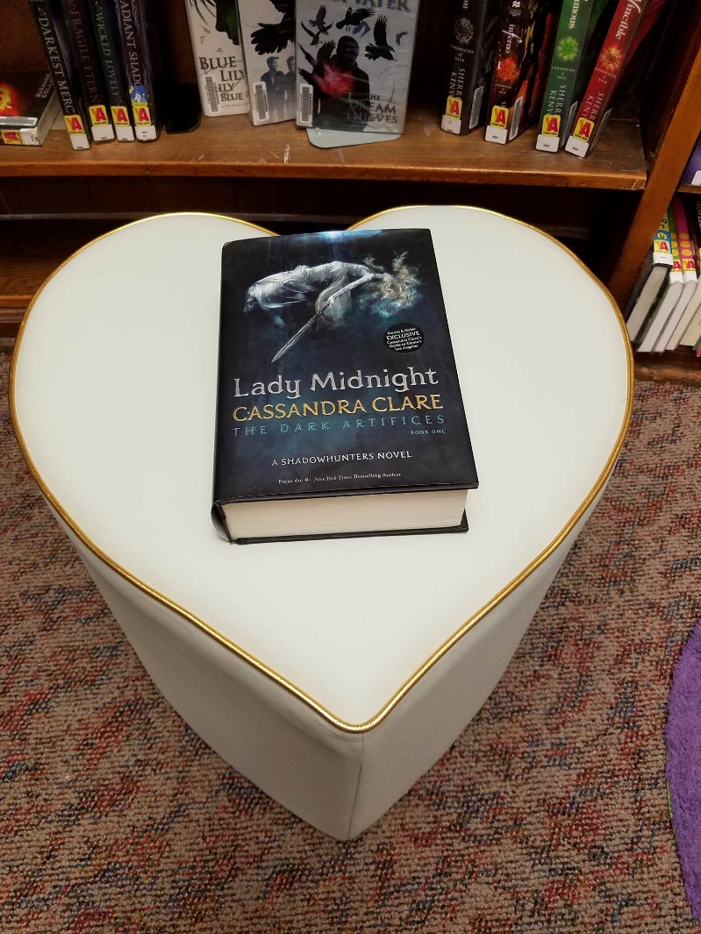
Why adult should read YA
Great page turners
Shorter Reads (not always true…book pictured is 720 pages)
Easier to follow
Quicker character development and story
Find more relatable titles and wider directions
Makes you think of issues you weren’t even aware of
Helps parents stay in touch with their kids, what they're reading and what they're learning.
Despite losing some of the sex, language, and violence of adult books, they do not lose one ounce of the story.
It's important to support ALL literature, even if it's out of your comfort zone. There are some dang good literature in that genre that a lot of people miss because they have deemed it a "kids" book.
fast-paced, with rich character dialogue and hidden plot points

Slide 16
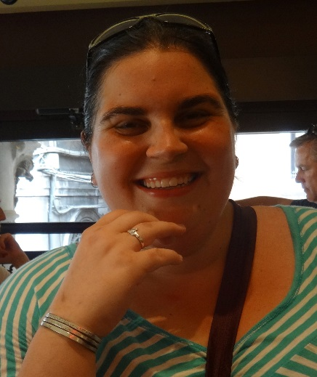
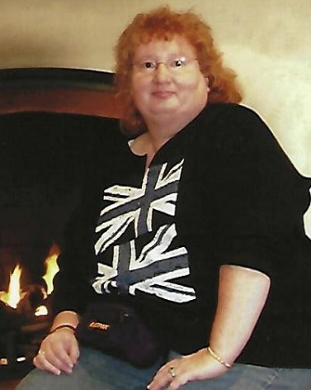
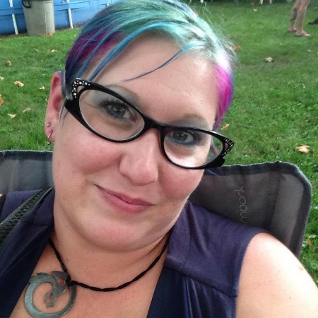
Contributors:

Slide 17
Problems with being an adult reading YA
You accidentally agree with the parents instead of the headstrong love sick teenager.
You are concerned about the fact that they’re not getting a full education
You get an intense crush on the love-interest until…you realize he’s 16 and you’re 10+years his senior.
http://paperfury.com/10-problems-of-being-an-adult-reading-ya/

Slide 18
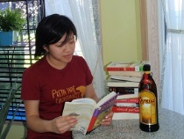
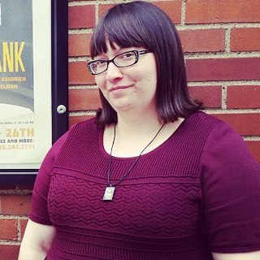
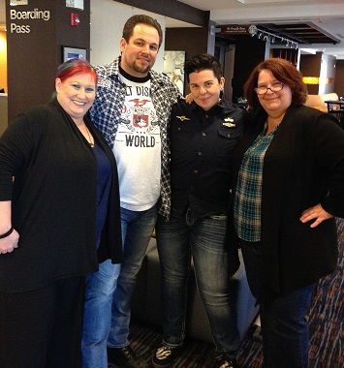
Swag and other goodies donated by:
Simon and Schuster
Rachel Caine
Lois from Baker & Taylor
Mandy Wan from ForeverYoungAdult.com
Me

