Slide 1
Maps, timelines, colors, and cats: Can DPLA help my patrons? Can my library participate?
Emily Jaycox
Missouri History Museum
emily@mohistory.org

Slide 2
First, a disclaimer…

Slide 3
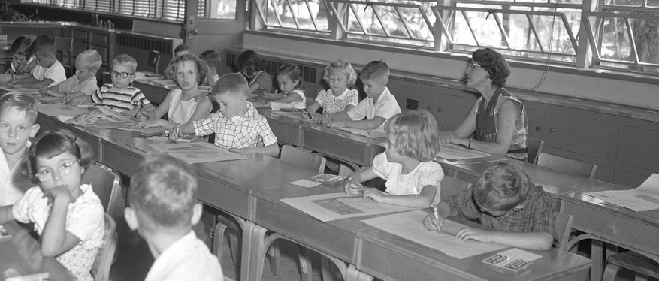
And a quiz:

Slide 4
Are you…
Public service / instruction staff
Metadata wrangler
App developer
Administrator

Slide 5
Are you…
Public service / instruction staff
Metadata wrangler
App developer
Administrator
…..Just curious?

Slide 6
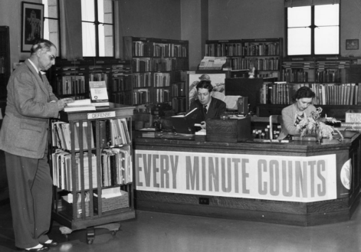
Public services / instruction
Are you or your patrons frustrated at hopping around to different websites to locate digitized primary source material?
Learn more about DPLA's portal and searching tools.

Slide 7
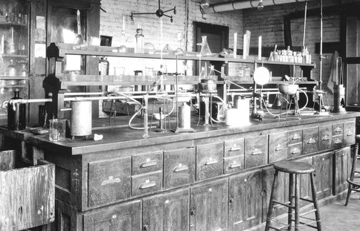
App developer
Are you a data person who wishes that all our library catalogs and metadata could be repurposed?
See examples of DPLA's application programming interface (API) used for novel discovery tools and engaging apps

Slide 8
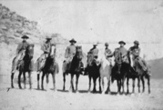
Metadata wrangler
Does your library have digital content that you think could be contributed to DPLA?
Learn more about the data requirements for contributing content

Slide 9
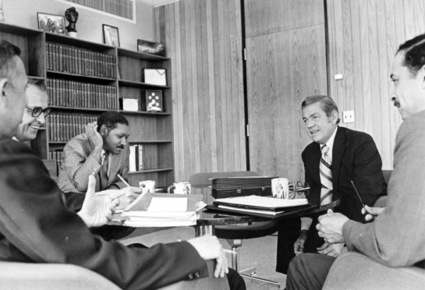
Administrator
Are you wondering about steps and costs for contributing to DPLA?
Learn about what DPLA is…and what it is not;
and more about the path to membership

Slide 10
Just curious?

Slide 11
DPLA: What it is…
Visit dp.la

Slide 12
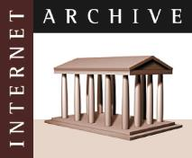
CONTENT HUBS – large providers
Notes:
For large institutions with 250,000 or more unique metadata records – DPLA works with them directly. This can be an option if your institution is large enough.
The Content hubs are large digital libraries, museums, archives, or repositories that maintain a one-to-one relationship with the DPLA. Content hubs, as a general rule, provide more than 250,000 unique metadata records that resolve to digital objects (online texts, photographs, manuscript material, art work, etc.) to the DPLA, and commit to maintaining and editing those records as needed.
Content hubs include the following institutions:
ARTstor
Biodiversity Heritage Library
David Rumsey Map Collection
Harvard Library
HathiTrust Digital Library
National Archives and Records Administration (NARA)
New York Public Library
Smithsonian Institution
University of Illinois at Urbana-Champaign
University of Virginia

Slide 13
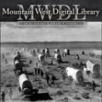
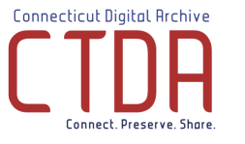
SERVICE HUBS - collaboratives
Notes:
DPLA Service hubs are state or regional digital libraries that aggregate information about digital objects from libraries, archives, museums, and other cultural heritage institutions within its given state or region. Each Service hub offers its state or regional partners a full menu of standardized digital services, including digitization, metadata assistance and training, data aggregation and storage services, as well as locally hosted community outreach programs, bringing users in contact with digital content of local relevance.
You can view a complete, up-to-date list of all DPLA Service Hubs at http://dp.la/info/hubs/.

Slide 14
CONTENT AND SERVICE HUBS
APPS
FRONT END
API
DPLA PLATFORM
METADATA REPOSITORY
INGESTION
SERVICE HUBS
CONTENT HUBS
Notes:
How critical is the Export bubble to this diagram?
This is a recreation of the diagram in the DPLA strategic plan p. 15 http://dp.la/info/wp-content/uploads/2015/01/DPLA-StrategicPlan_2015-2017-Jan7.pdf

Slide 15
APPS
FRONT END
API
DPLA PLATFORM
METADATA REPOSITORY
INGESTION
SERVICE HUBS
CONTENT HUBS
Notes:
DPLA is a METADATA repository. It does not host digital assets
How critical is the Export bubble to this diagram?
This is a recreation of the diagram in the DPLA strategic plan p. 15 http://dp.la/info/wp-content/uploads/2015/01/DPLA-StrategicPlan_2015-2017-Jan7.pdf

Slide 16
Service hub model (MoHub is a service hub)
PONDS LAKES OCEAN
Local
Regional
National
Users / Visitors / Researchers
Notes:
To help visualize the relationship between the different pieces of the Service hub relationship, one can imagine your local historical society or public library as a pond, containing in it unique, valuable cultural content. These ponds send their content through tributaries to the lakes, the DPLA Service hubs, which aggregate data from the various cultural heritage institutions across their state or region, the ponds. The Service hubs then feed this content through rivers to the ocean, the DPLA.

Slide 17
A PORTAL FOR DISCOVERY
A PLATFORM TO BUILD UPON
A STRONG PUBLIC OPTION
Visit dp.la

Slide 18
A PORTAL FOR DISCOVERY
A PLATFORM TO BUILD UPON
A STRONG PUBLIC OPTION
DPLA: the front end
Visit dp.la

Slide 19
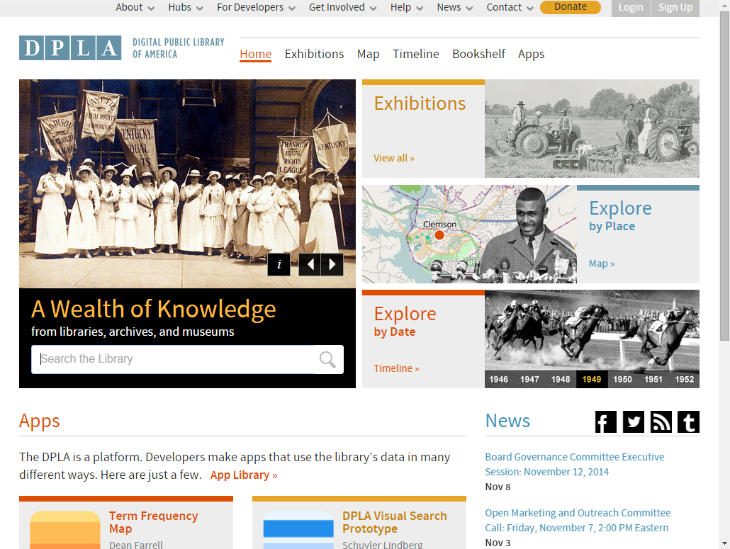
ozarks
Notes:
Over 10 million records provided by over 1600 institutions as of DPLA Fest 2015.
In order for our users to find it here . . . We need to talk about how does the metadata get to DPLA?

Slide 20
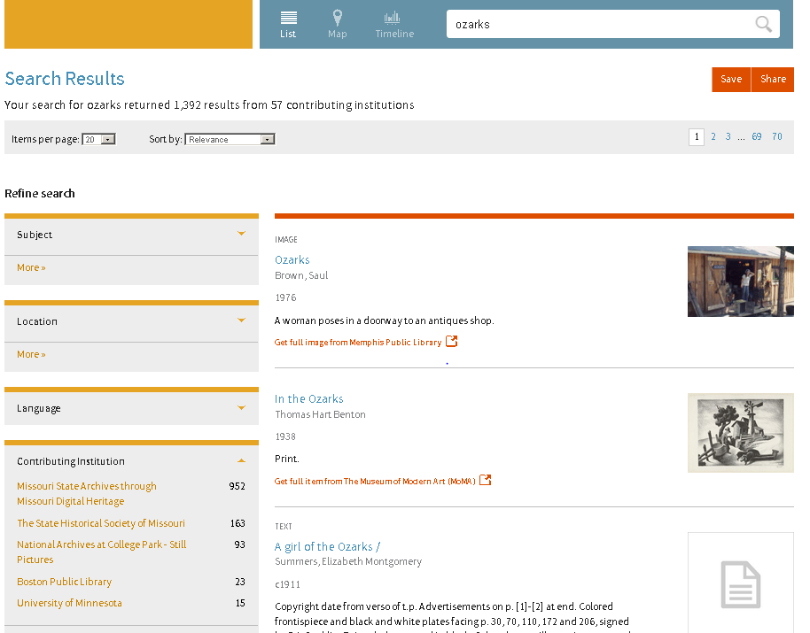

Slide 21
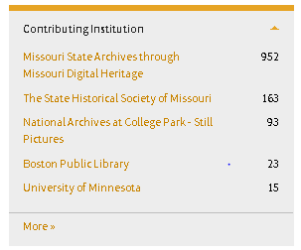

Slide 22
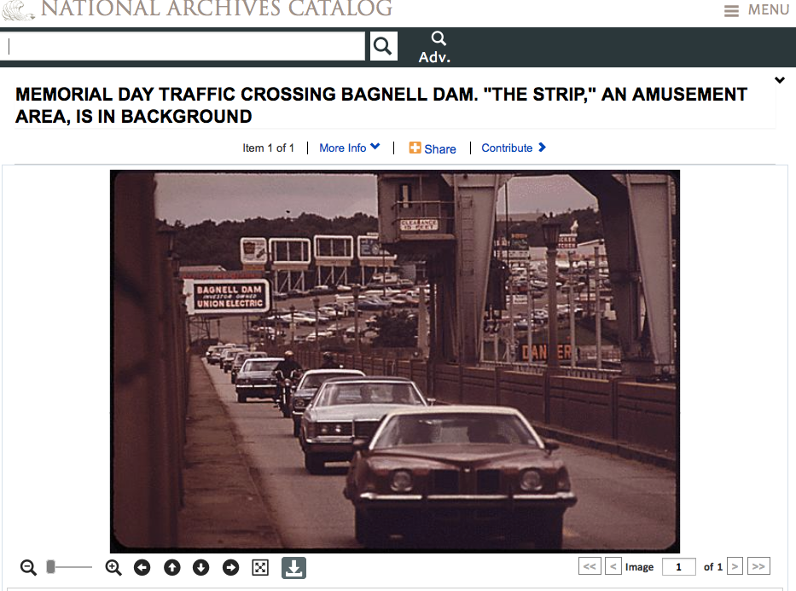

Slide 23
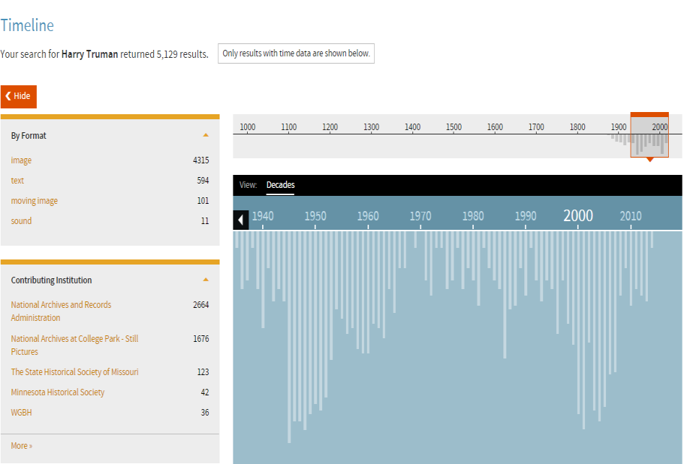
Timeline Search

Slide 24
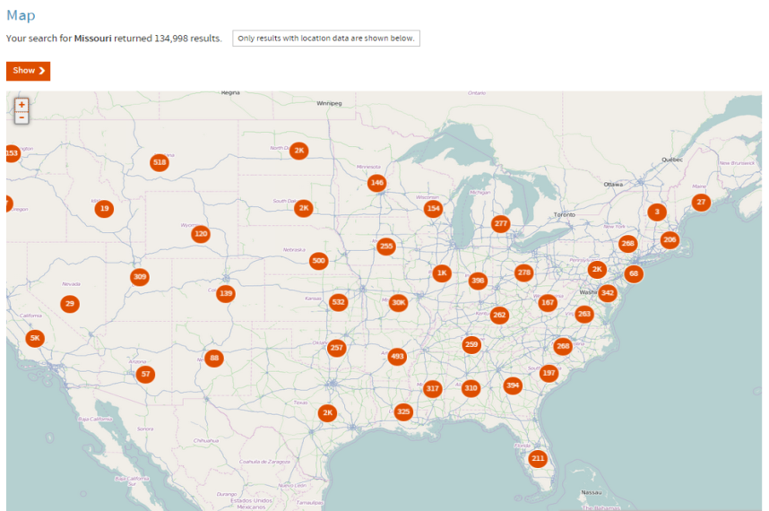
Map Search

Slide 25
CURATED COLLECTIONS
Visit dp.la

Slide 26
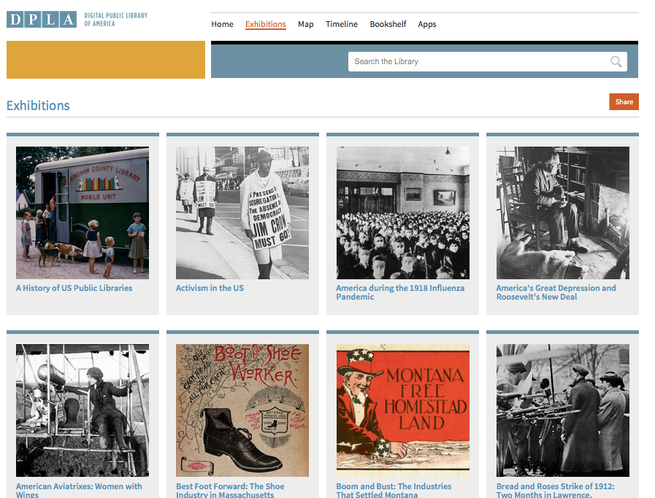
Notes:
I’m not sure how much of the background/story of formation of Missouri Hub you want to tell
Update with most recent statistics

Slide 27
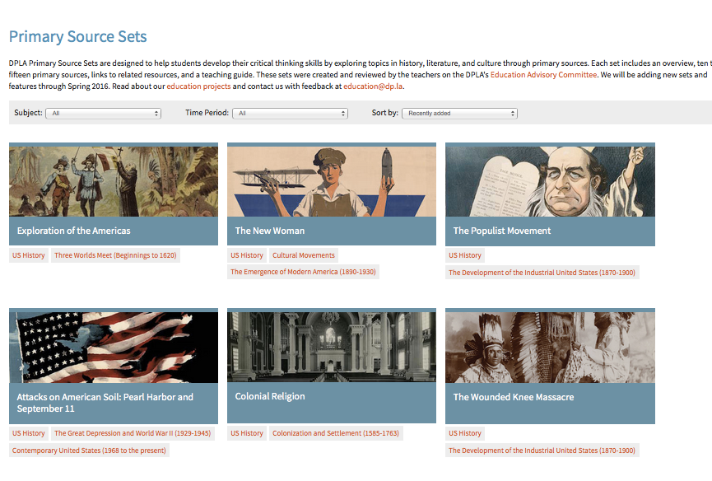

Slide 28
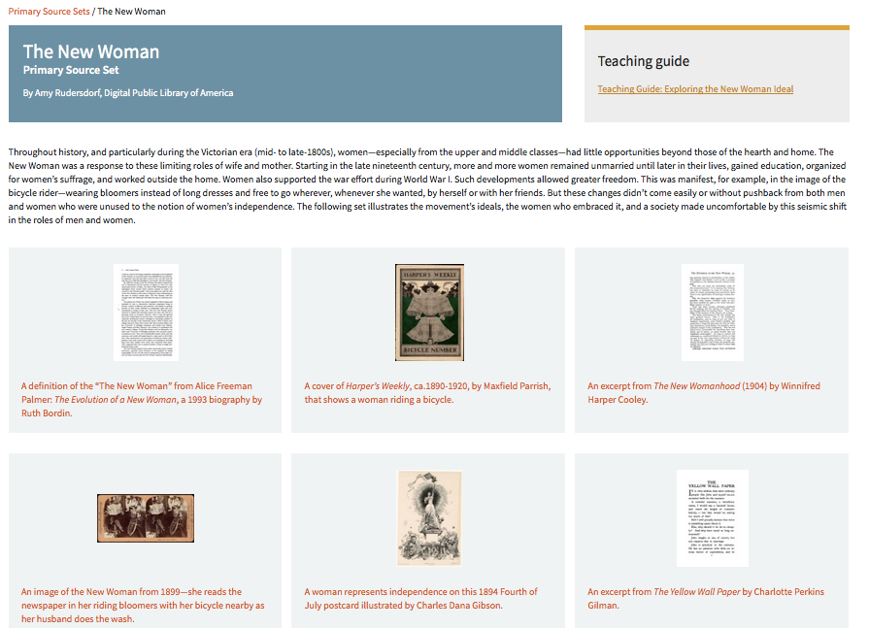

Slide 29
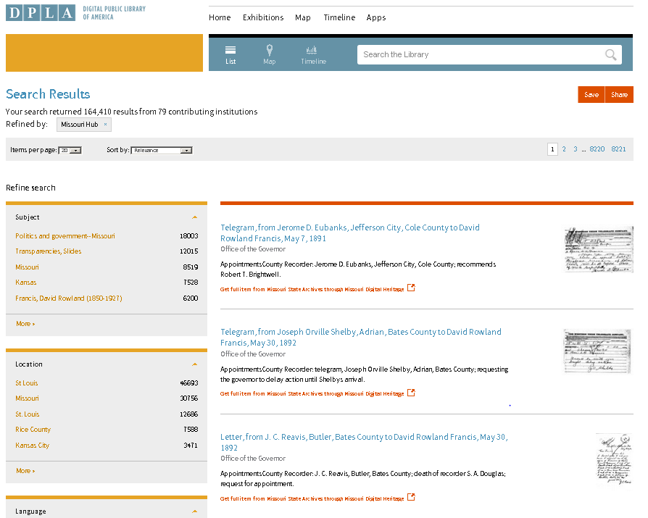
Facet for hub; no separate web portal

Slide 30
A PORTAL FOR DISCOVERY
A PLATFORM TO BUILD UPON
A STRONG PUBLIC OPTION
Visit dp.la

Slide 31
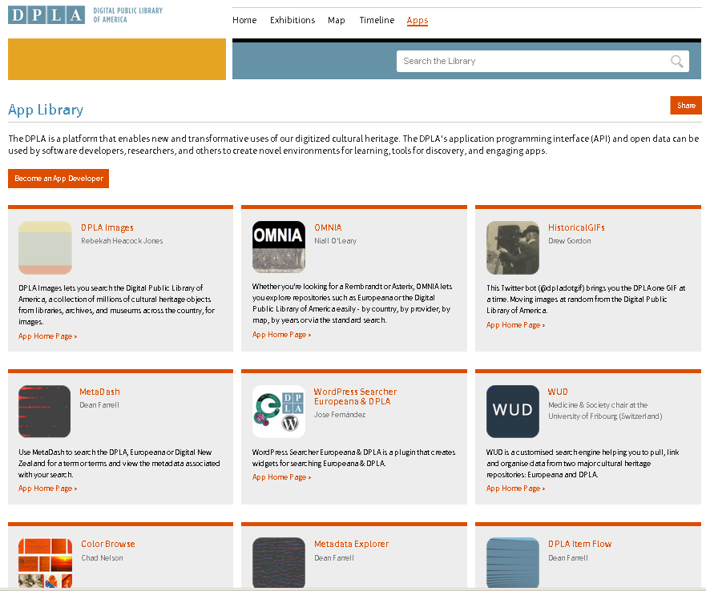

Slide 32
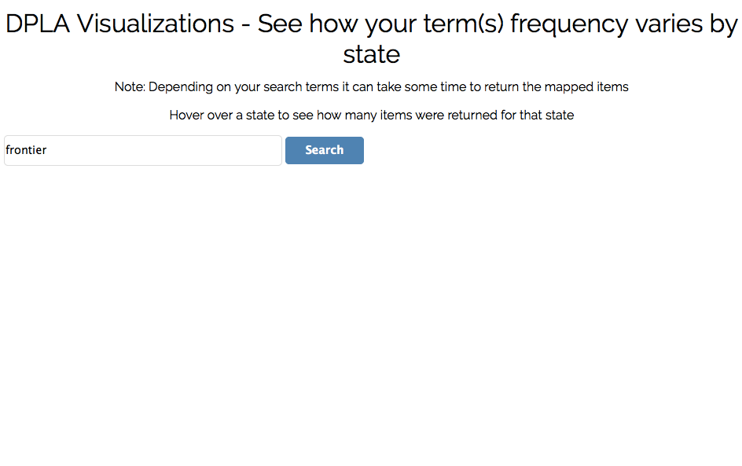
frontier

Slide 33
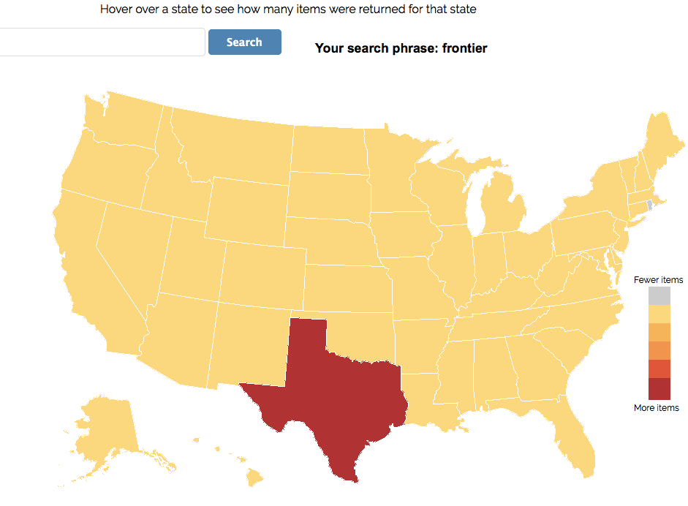

Slide 34
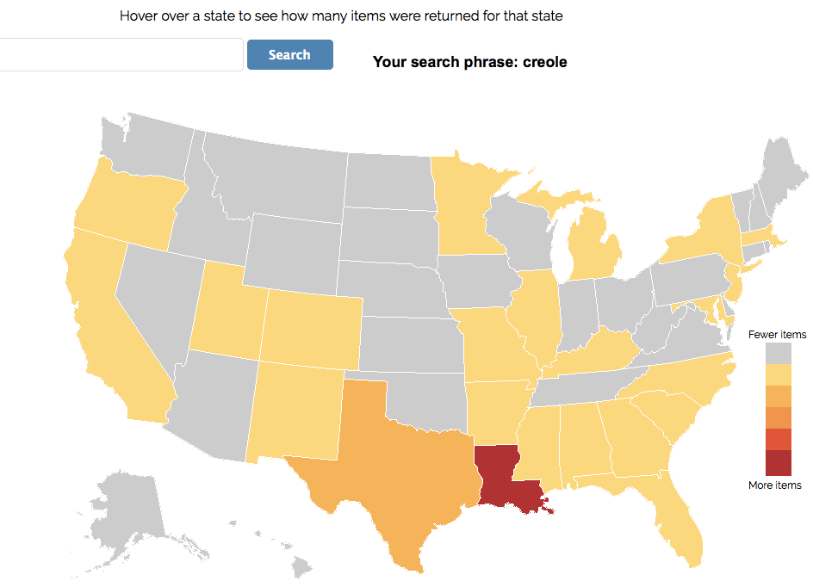
Your term(s) appeared in 9 records in Missouri
Click to view records in Missouri

Slide 35
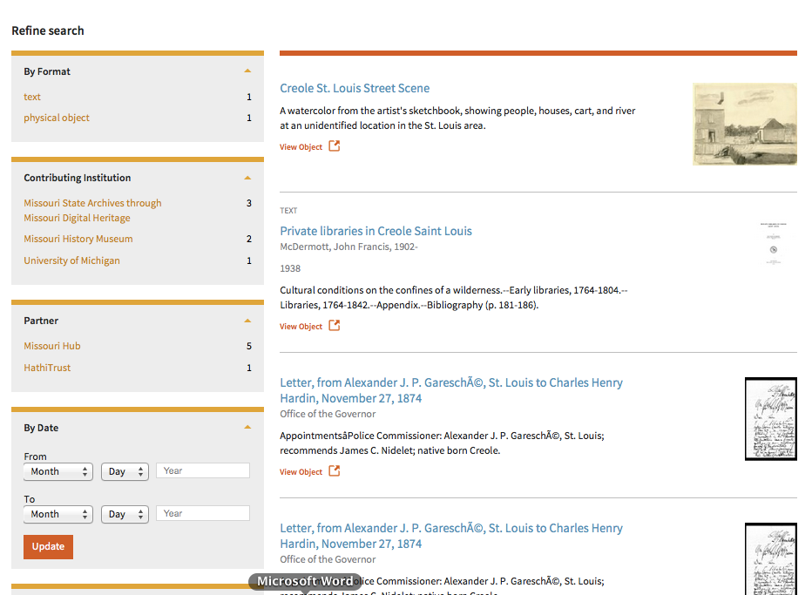

Slide 36
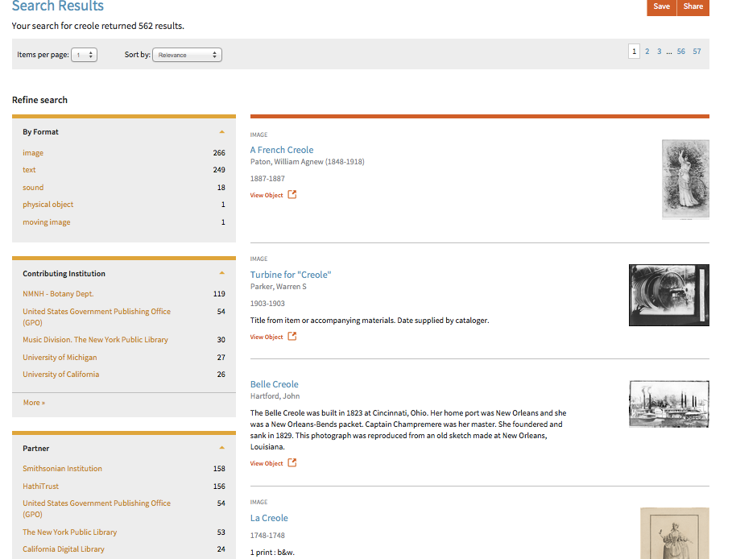

Slide 37
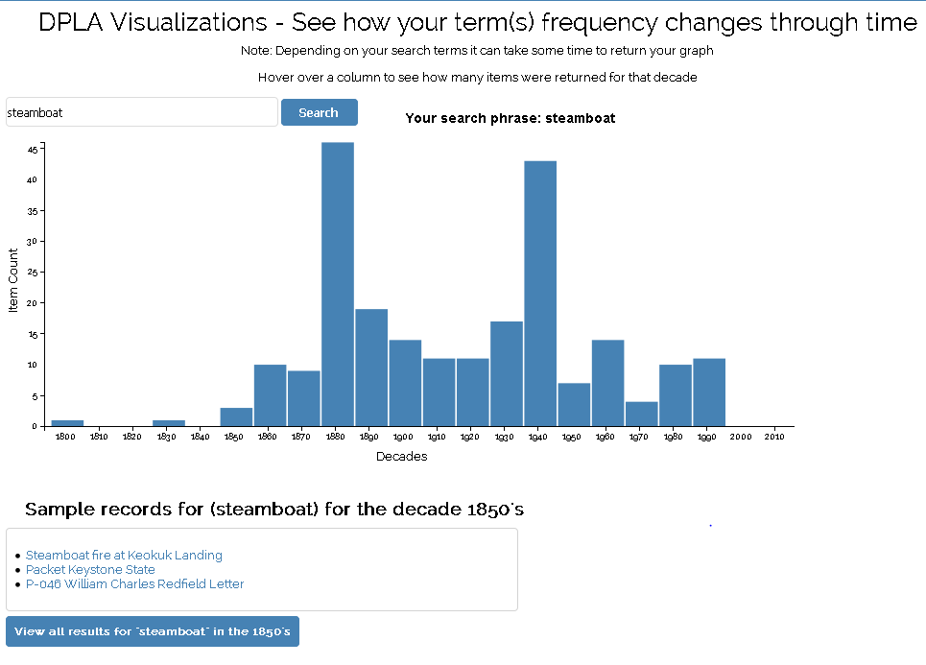
Steamboat

Slide 38
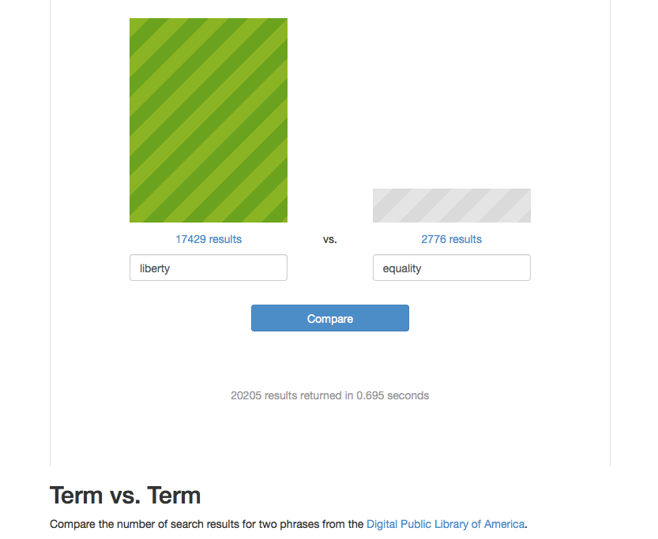

Slide 39
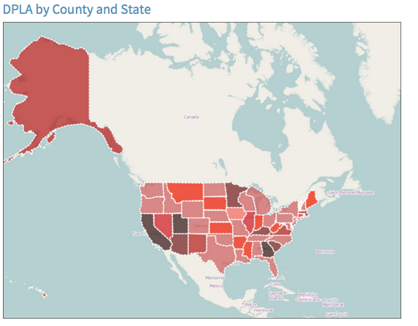

Slide 40
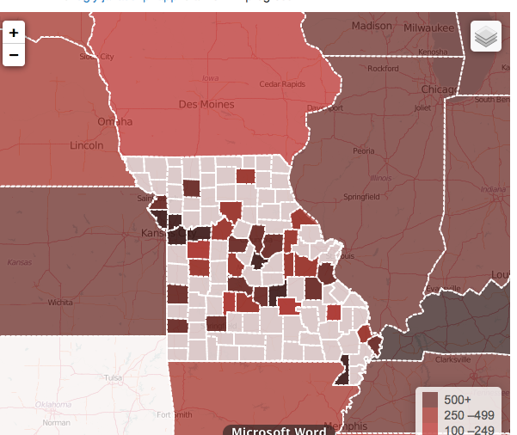

Slide 41
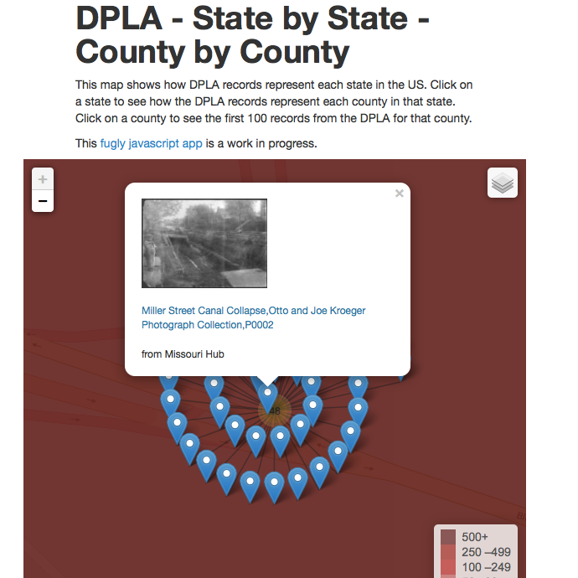

Slide 42
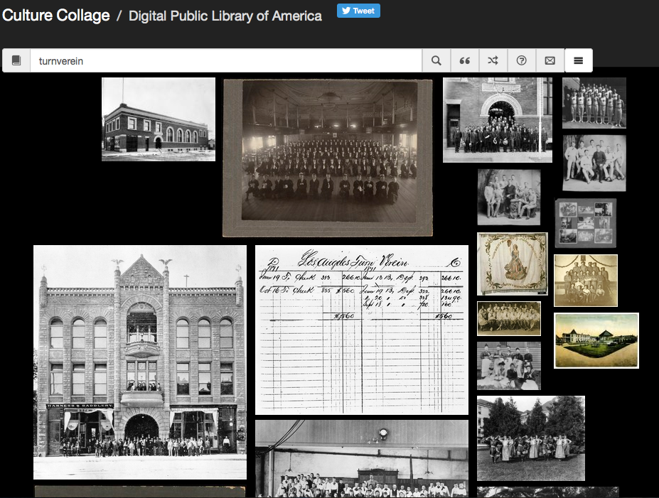

Slide 43
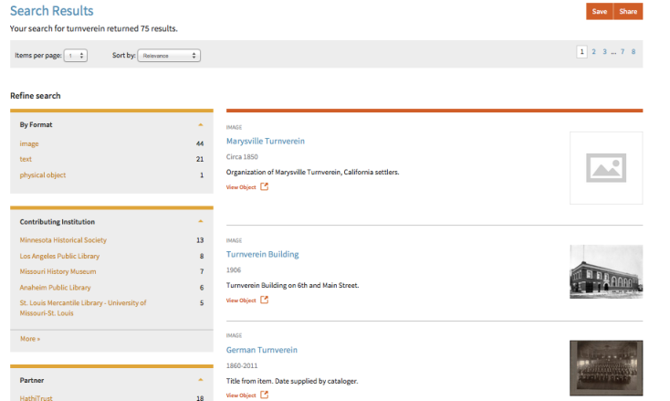

Slide 44
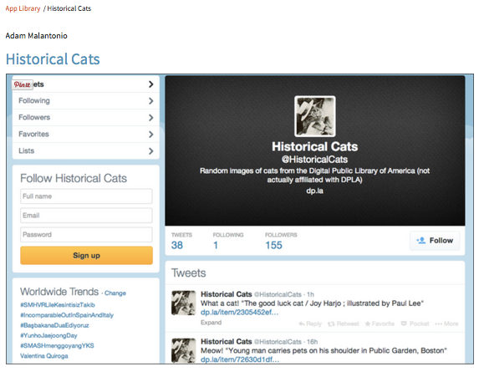

Slide 45
A PORTAL FOR DISCOVERY
A PLATFORM TO BUILD UPON
A STRONG PUBLIC OPTION
Visit dp.la

Slide 46
HOW DOES THE MEAT GET INTO THE SAUSAGE?
A PORTAL FOR DISCOVERY
A PLATFORM TO BUILD UPON
A STRONG PUBLIC OPTION
Visit dp.la

Slide 47
DPLA: What it is not
Visit dp.la

Slide 48
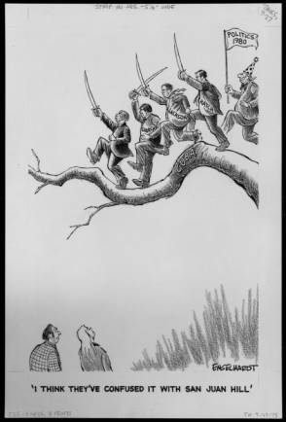
does not host digital assets.

Slide 49
Two prerequisites to joining DPLA through MissouriHub
Visit dp.la

Slide 50
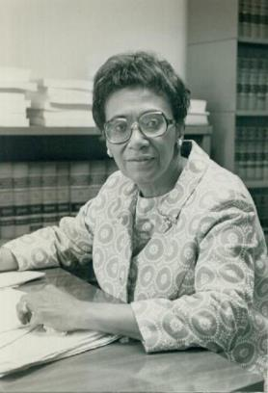
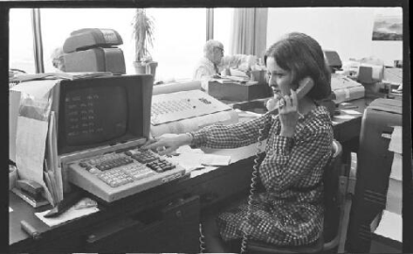
ADMINISTRATIVE
TECHNICAL

Slide 51
Administrative steps
Visit dp.la

Slide 52
Administrative
Sign Memorandum of Understanding (MOU)
Participate in governance
Annual member meeting at MLA
Steering committee has monthly conference call, meets as needed

Slide 53
Memorandum of understanding
Statement of mutual expectations
No fees involved*
*at this time
Not a legal contract
Signed by Missouri History Museum on behalf of Missouri Hub
Signed by an administrator at your institution
MOU
________________________________________________________________________________
____________________
____________________
X______
X______
Notes:
Alternatively we could use an icon of MoHub or image of Emily or David – who signs for MoHub?
Is this too simple – is audience familiar with an MOU?

Slide 54
Missouri Hub agrees to:
Aggregate and pass metadata to DPLA
Facilitate communication between DPLA and contributor institutions
Facilitate compliance of contributor metadata to DPLA requirements
MOU
________________________________________________________________________________
___________________________
__________________________
X_Missouri Hub__
X_Your Institution__
Notes:
Mutual expectations – what does each party agree to:

Slide 55
Contributing Institution agrees to:
Contributing Institution
Have their metadata added to DPLA
Adhere to metadata requirements for DPLA
Provide metadata under a Creative Commons 1.0 (CC0) license
Metadata provided by Contributor is licensed to the public non-exclusively, unconditionally, and royalty-free for all types of use.
Notes:
Mutual expectations – what does each party agree to:
Comment about third-party metadata?

Slide 56
Other Key Points:
is NOT a long-term repository for metadata
can choose which metadata it accepts
Contributing Institution
can choose which metadata it contributes
Contributing Institution
can choose to cease participation at any time
Notes:
Mutual expectations – what does each party agree to:

Slide 57
Who in your organization can sign the memorandum of understanding?
?
Notes:
Question for audience members – think about your organization. Do you know who would sign the MOU? Is it you?
Add link to full MOU?
Transition – once you sign the MOU then one member from your organization can represent your institution on the MOHub Partners Council

Slide 58
Technical steps
Visit dp.la

Slide 59
Minimum Metadata Standards
All metadata supplied as CC0
OAI-PMH data feed
Dublin Core or MODS metadata

Slide 60
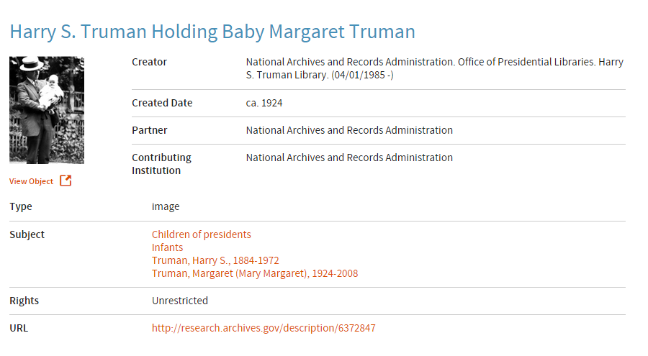
Five metadata fields each record must have:
Title Field
Contributing Institution
URL to thumbnail / preview
Rights Statement
URL to record
Notes:
Each Record Must have These Five Fields

Slide 61
Metadata Requirement | Dublin Core | MODS | Notes
Title value | title | <title> within first <titleInfo>
URL to publicly available representation of the record | URL in first identifier | URL in <url> tag within first <location>
URL to publicly available “preview” or “thumbnail | URL in last identifier | URL in last <location> in the record | Image no larger than 150 ppi on any side Missouri Hub can work with contributor if URL is not in record
Rights statement | rights | <accessCondition> | Contributor can also provide a statement to be applied to all records
Contributing institution identifying statement | publisher | <publisher> within the first <originInfo> tag | Contributor can also provide a statement to be applied to all records
Type value* should conform with DCMI Type Vocabulary | type | <typeOfResource> | * Strongly recommended
Additional metadata fields may be included. These should conform to DPLA’s Metadata Application Profile. http://dp.la/info/developers/map/
Notes:
I think this slide may be better on a postcard handout?
May want to look at table about North Carolina’s service hub -- in http://www.dlib.org/dlib/july14/gregory/07gregory.html
Photo and contact information? Mimic slide of MOU – two folks connecting. Here you want technical leads connecting with David

Slide 62
Who in your organization knows your metadata?
?
Notes:
Question for audience members – think about your organization. Do you know who knows the answers to the technical questions? Is it you?

Slide 63
?
Technical contact for partner institution
David Henry of the Missouri History Museum, technical coordinator for MissouriHub.

Slide 64
How does MoHub relate to
Missouri Digital Heritage?
Visit dp.la

Slide 65
State-wide content platform
Hosts digitized primary sources | Onramp to DPLA
Also provides links to material hosted on other libraries’ repositories | Provides links to material hosted on other libraries’ repositories
Supports new digitization projects via LSTA grants | Works with already digitized collections only
Has a website and search portal | No search portal; website is adminstrative only
Aggregator of metadata

Slide 66
Two paths to becoming a partner
Visit dp.la

Slide 67
If you host your own content…
Your Institution Here!
ADMINISTRATIVE
TECHNICAL
Notes:
Partner or member?
Not sure on the third bullet point
I’m not sure on the order of this slide – may want MOU, Technical feasibilty and then send metadata/partners council

Slide 68
If your content is at MDH…
Your hosted assets
ADMINISTRATIVE
TECHNICAL
Notes:
Partner or member?
Not sure on the third bullet point
I’m not sure on the order of this slide – may want MOU, Technical feasibilty and then send metadata/partners council

Slide 69
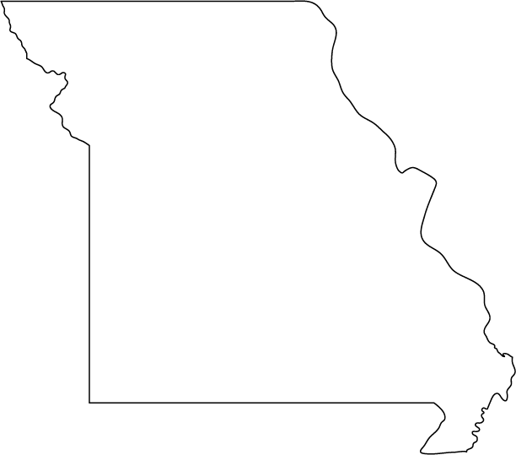
Washington University
Federal Reserve Bank of
St. Louis
UM – St. Louis
Missouri History Museum
St. Louis Public Library
Kansas City Public Library
Saint Louis University
Missouri Botanical Garden
Linda Hall Library
State Historical Society of Missouri
Missouri State Archives
Metadata
Springfield – Greene Co. Public Library
Notes:
The Missouri Hub is an aggregator
Onramp to DPLA
Pulls content from MDH as well as other repositories within MO that are not in MDH
Aggregator is a silent utility without a user interface

Slide 70
A PORTAL FOR DISCOVERY
A PLATFORM TO BUILD UPON
A STRONG PUBLIC OPTION
Visit dp.la

Slide 71
Bringing together the riches of America’s libraries, archives, and museums to make them freely available to the world
visit dp.la

Slide 72
Bringing together the riches of America’s libraries, archives, and museums to make them freely available to the world
Why DPLA?
visit dp.la

Slide 73
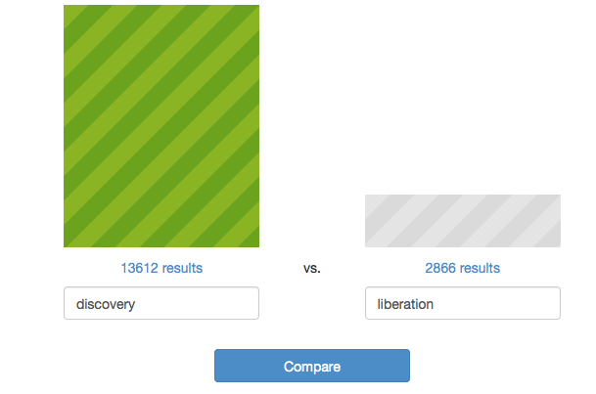
Visit dp.la

Slide 74
Visit dp.la
Thank you!
Questions?
emily@mohistory.org
http://data.mohistory.org/
mohub/

Slide 75
Visit dp.la

Slide 76
Photo credits:
Again sheet music: http://omeka.wustl.edu/omeka/scripto/transcribe/3005/7741#transcription
John S. Rendleman: https://dl.mospace.umsystem.edu/umsl/islandora/object/umsl%3A52972
Municipal Reference Library, Reference desk http://jpg1.lapl.org/pics38/00038504.jpg
Cattlemen at Dragon: http://content.lib.utah.edu/cdm/ref/collection/Uintah_History/id/7024
Laboratory: http://kdl.kyvl.org/catalog/xt7prr1pgv6h_168_3/viewer
Frankie Freeman in her law office: http://collections.mohistory.org/resource/143400.html
Women at work in the Stifel, Nicholas and Company offices:
http://collections.mohistory.org/resource/221301

