Slide 1
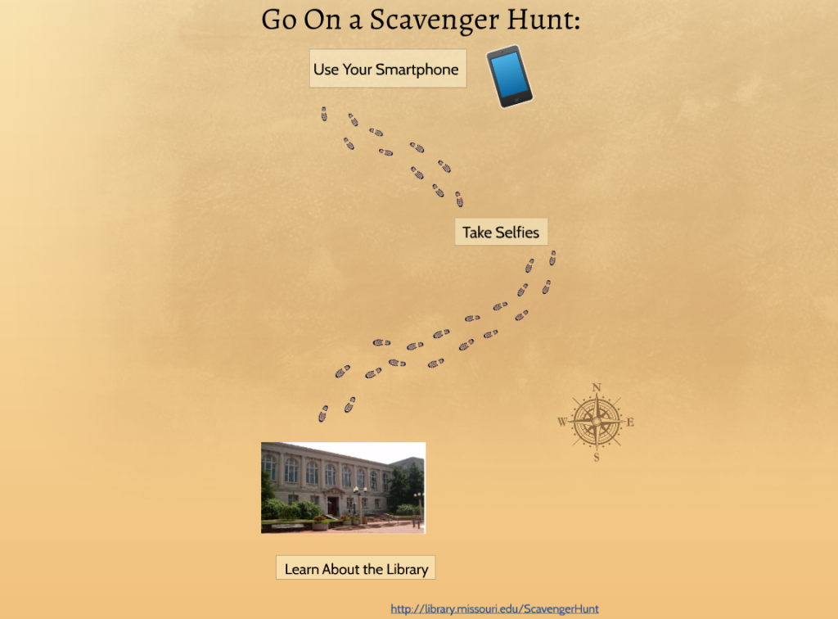
Smart Phones and Scavenger Hunts: A Mobile Introduction to the Library
Presenters:
Kimberly Moeller &
Noël Kopriva,
MU Libraries
Image from http://library.missouri.edu/news/tag/scavenger-hunt

Slide 2
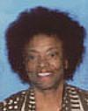
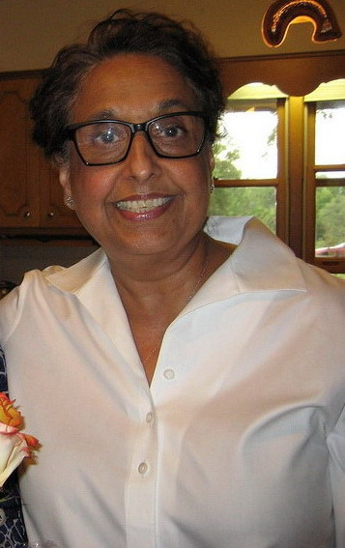
MU Libraries instruction committee 2015-2016
The Leader: Goodie Bhullar
The editor: Rebecca Graves
The f2f coder & peacemaker: Paula Roper
The skeptic:
Noël Kopriva
The logician: Rachel Brekhus
The qualtrics guy: Nav Khanal
The Fixer: Kimberly Moeller
Notes:
Noel

Slide 3
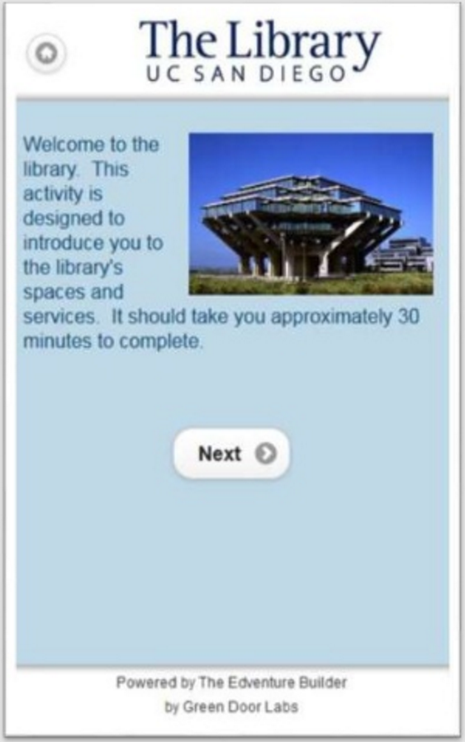
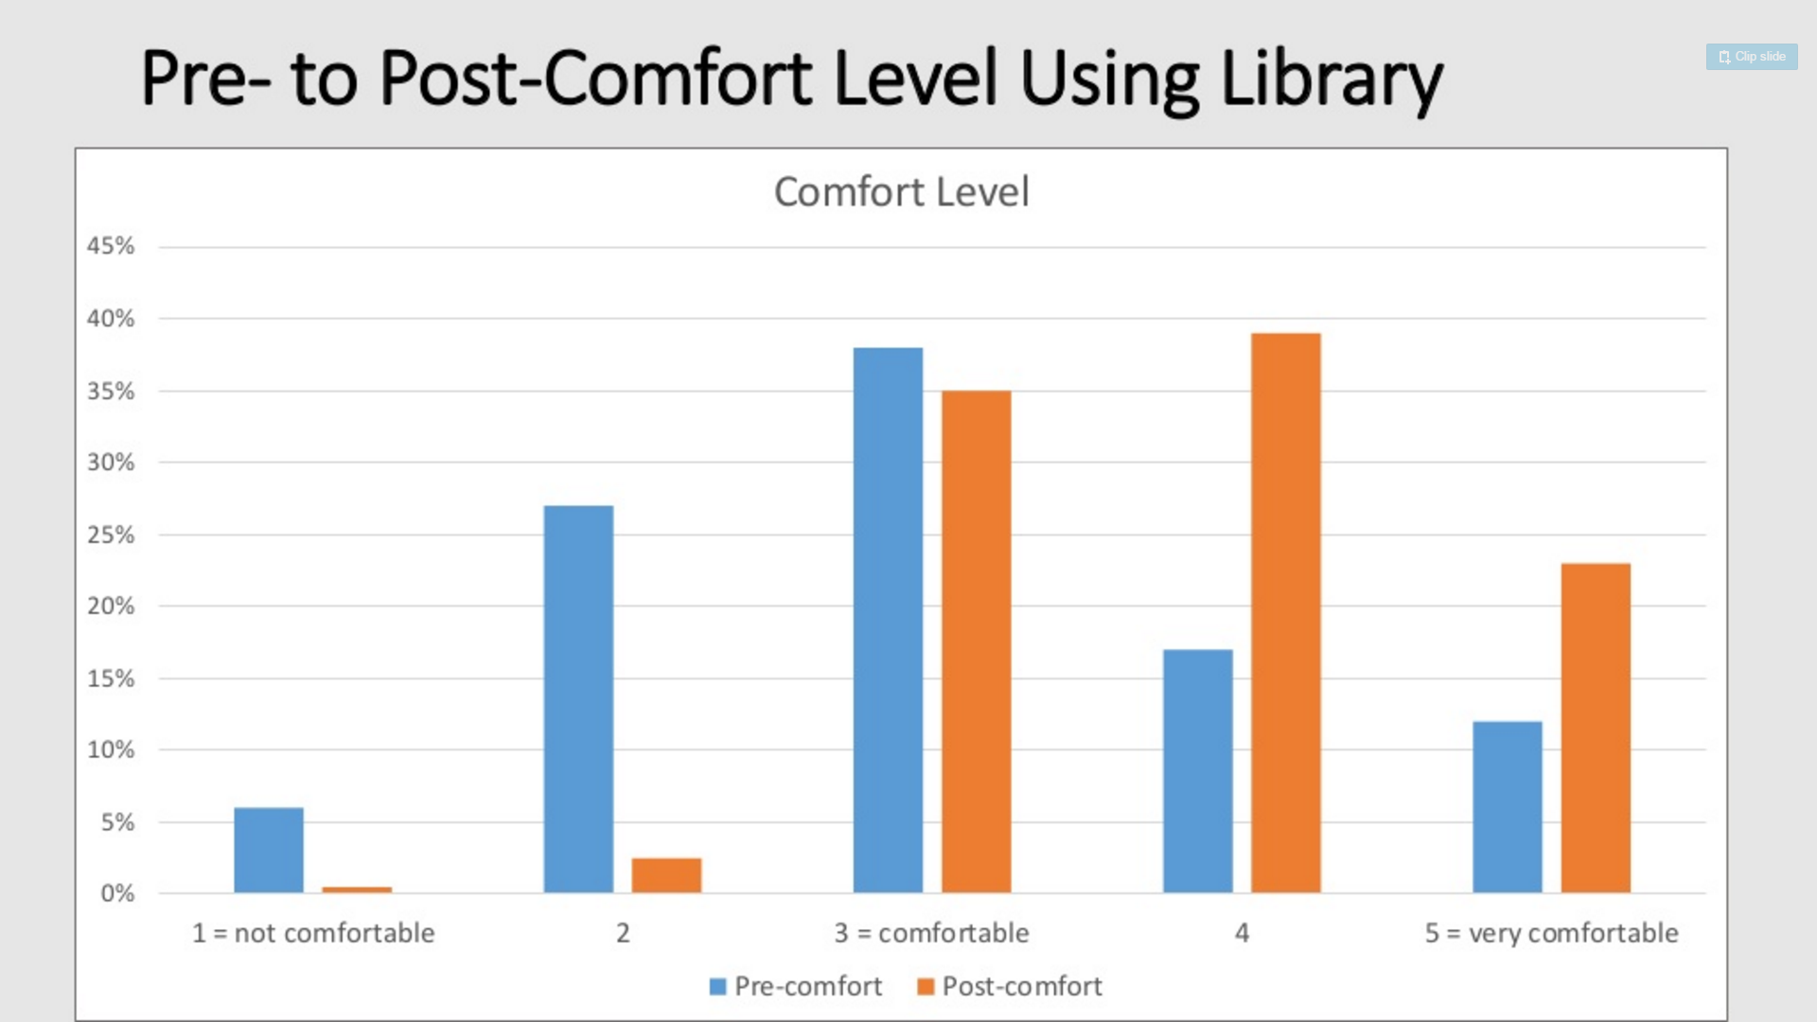
Inspiration
Inspiration
Goldman et al. Crafting Freshman Engagement: A Study of Library Orientations in the Fledgling First Year Experience Program at UC San Diego. Conference presentation, LOEX Annual Conference, May 2015. http://www.loexconference.org/2015/presentations/goldmanPresentation.pdf
Notes:
Kim--Students became more comfortable using the library after their library orientation experiences. Before the scavenger hunt, 32% of students surveyed said they were not comfortable using the library; after the scavenger hunt, that figure dropped to about 3%.
Why it worked for MU - staffing for classes

Slide 4
Literature About Library Scavenger Hunts
Recent
Cerny, J., and Holcomb,J. (2012). "Using a QR Code Scavenger Hunt to Promote Library Services to Teens." Virginia Libraries 58 (1), 39-42.
Renner, B. R., Cahoon, E., & Allegri, F. (2016). Low-Tech Scavenger Hunt Model for Student Orientation. Medical Reference Services Quarterly, 35(4), 372-387.
Rugan, E. e., & Nero, M. m. (2013). Library Scavenger Hunts: The Good, the Bad, and the Ugly. Southeastern Librarian, 61(3), 7-10.
Classic
"Library Book Yields Fake Crime Photo." (1993). American Libraries (24), 119.
McCutcheon, R. (1989). Can you find it?: 25 Library scavenger hunts to sharpen your research skills. United States of America: Free Spirit.
McCutcheon, R. (1990). "Library Scavenger Hunts: A Way Out of the Bewilderness." Wilson Library Bulletin (64), 38-40.
Notes:
Wrote up the experience for a paper and discovered a trend in the literature, namely rehabilitating the scavenger hunt with some emphasis on technology as the way to accomplish that goal. Generally speaking scavenger hunts were in, then out, and they’re kind of back in now, albeit those with a particular focus, and run by librarians, are most approved. My guess is that staffing issues have brought about this change; they certainly did for me. Noel

Slide 5
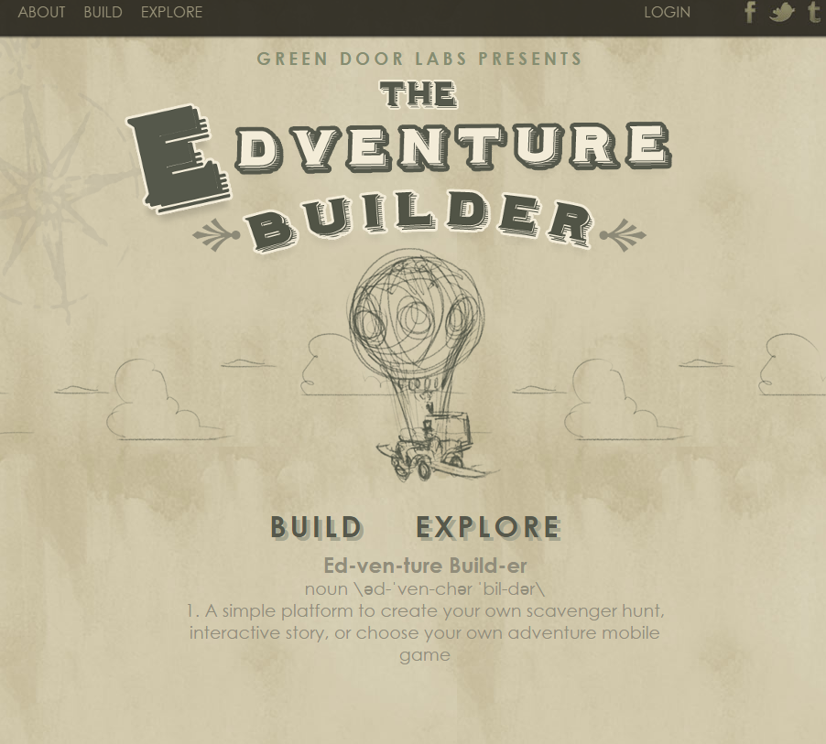
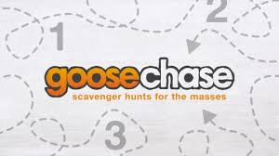
Software Platforms
Budget
Software product considerations
Contract with Qualtrics
Notes:
Kim

Slide 6
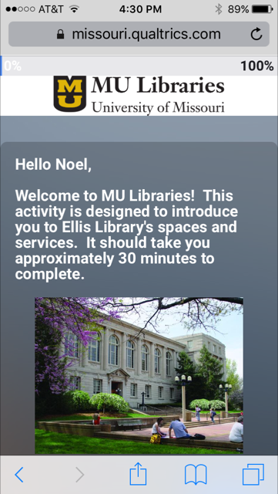
Scavenger Hunt Development
Focused on mix of physical and digital resources

Slide 7
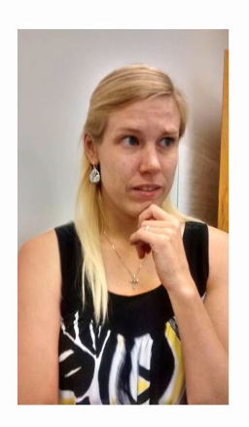
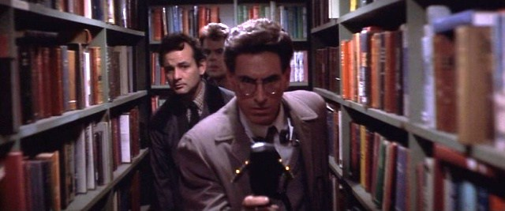
Marketing and Promotion
2015-2016
Promo Video
Instructor Contact
Library Poster
Fall 2016
Digital Signage
Instructor Contact
NewsHub/Blog
Future
http://tinyurl.com/ScavengerHuntPromo
http://library.missouri.edu/news/ellis-library/library-scavenger-hunt
Notes:
Kim

Slide 8
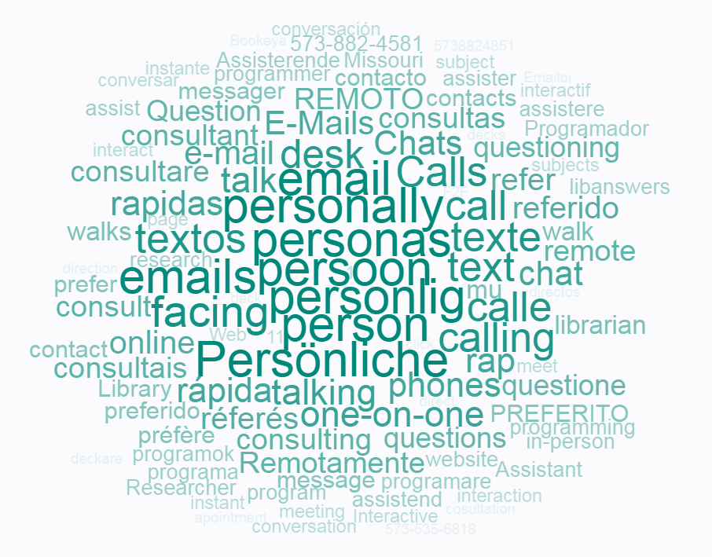
Student Response
Year 1: 2015-2016
1,095 students
80% response rate in three first-year courses
Readiness
Year 2: Fall 2016
346 students
Notes:
Readiness
Before: 3.12 (SD 1.42)
After: 4.37 (SD 0.89)

Slide 9
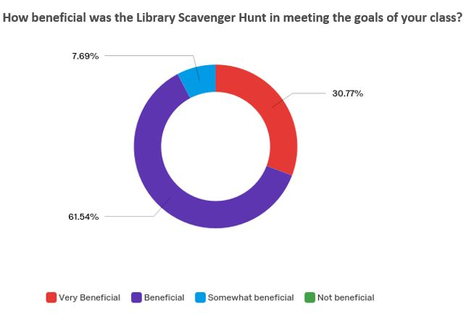
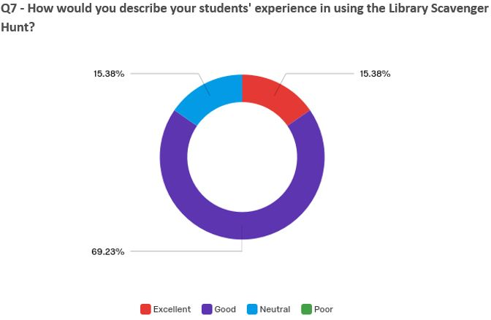
Instructor Survey

Slide 10
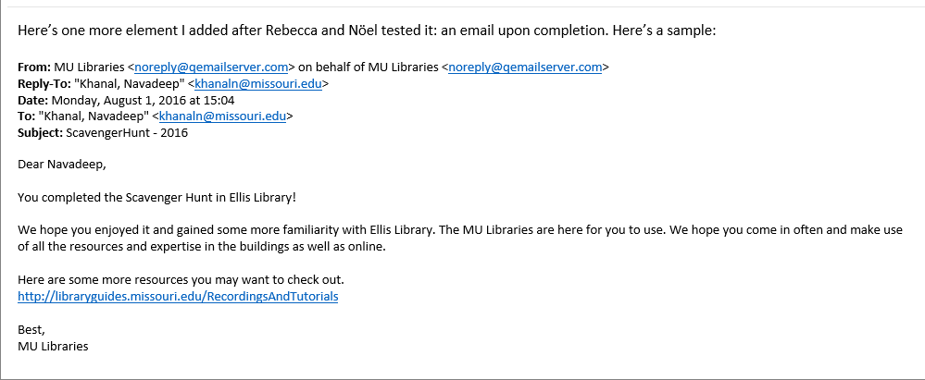
Other UpDates:
Added completion email so students can forward to their professors
Added Logins * Added Freshman Composition Favorite library location * Permissions

Slide 11
Challenges and Successes
Challenges
Longtime employee retirement (MU Libraries, Academic Affairs)
Marketing (chose not to redo video)
Reorganization (ours)
Successes
Recognition
Building Exploration
Notes:
Noel

Slide 12
Examples of Student Work:
Big space Yeah I’m talkin bout Ellis But look at all these resources Aren’t you jealous? Found my way around Now I can study If you get lost and need help I’m here for you, buddy!
It’s Ellis Library and it’s really rad The books on display make me really glad That I have all these great resources at my disposal For when I’m ready to write my thesis proposal
This Ellis building’s confusing and scary So of this scavenger hunt, I was wary But by the time I was done I’ll admit I had fun And now I love the Library
With a cup of coffee, I come to Ellis. With a mountain of assignments, I come to Ellis.
With a lack of sleep, I come to Ellis.
With a number of thoughts, I come to Ellis.
Oh Ellis, Oh Ellis, how old you are, and how resourceful.
Pacing back and forth, chasing high and deep, I find you in this unforgettable morning.
Will you remember me, like I remember you?
Chillin like a villain in the Criminology section
I’m over here at Ellis and you all should be jealous
This place has more books than your grandma’s collection of relics.
Don’t complain if you can’t find Dante’s circles of hell,
Just ask the lady at the front for help.
If your feet get sore take the elevator to fourth
And gawk at a view you’ve never seen before
It’s a stellar museum, a fantastical place
Just don’t get lost, remember, it’s not a race.
Library, library Do you hear my voice? I only hear your voice. Pen clicking, papers flipping... It is so good to hear from you.
This is the ocean where I belong
Notes:
Kim

Slide 13
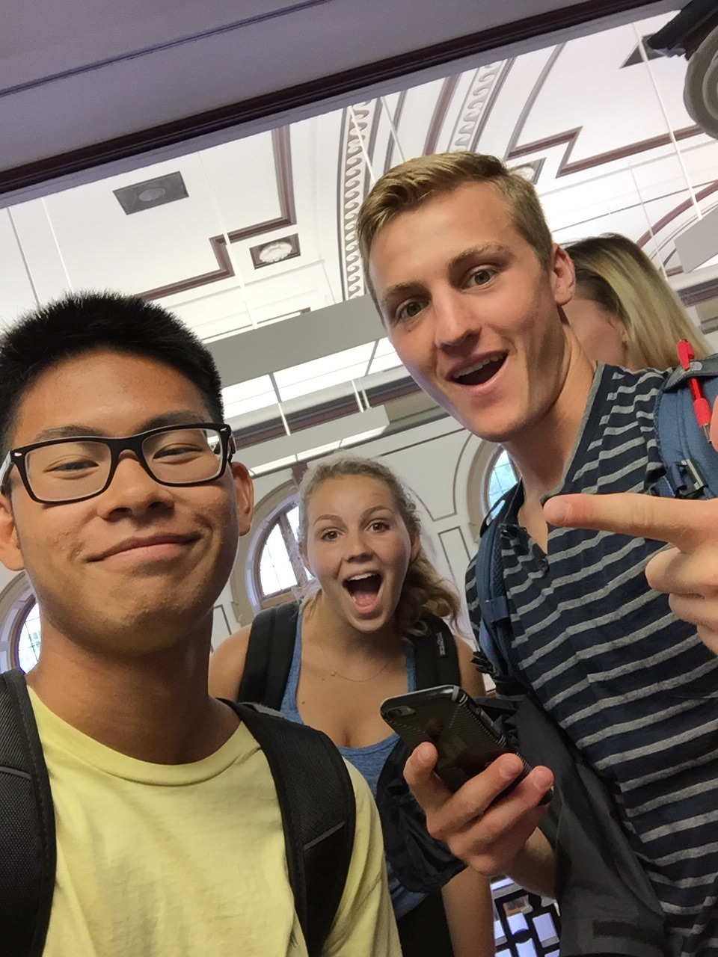
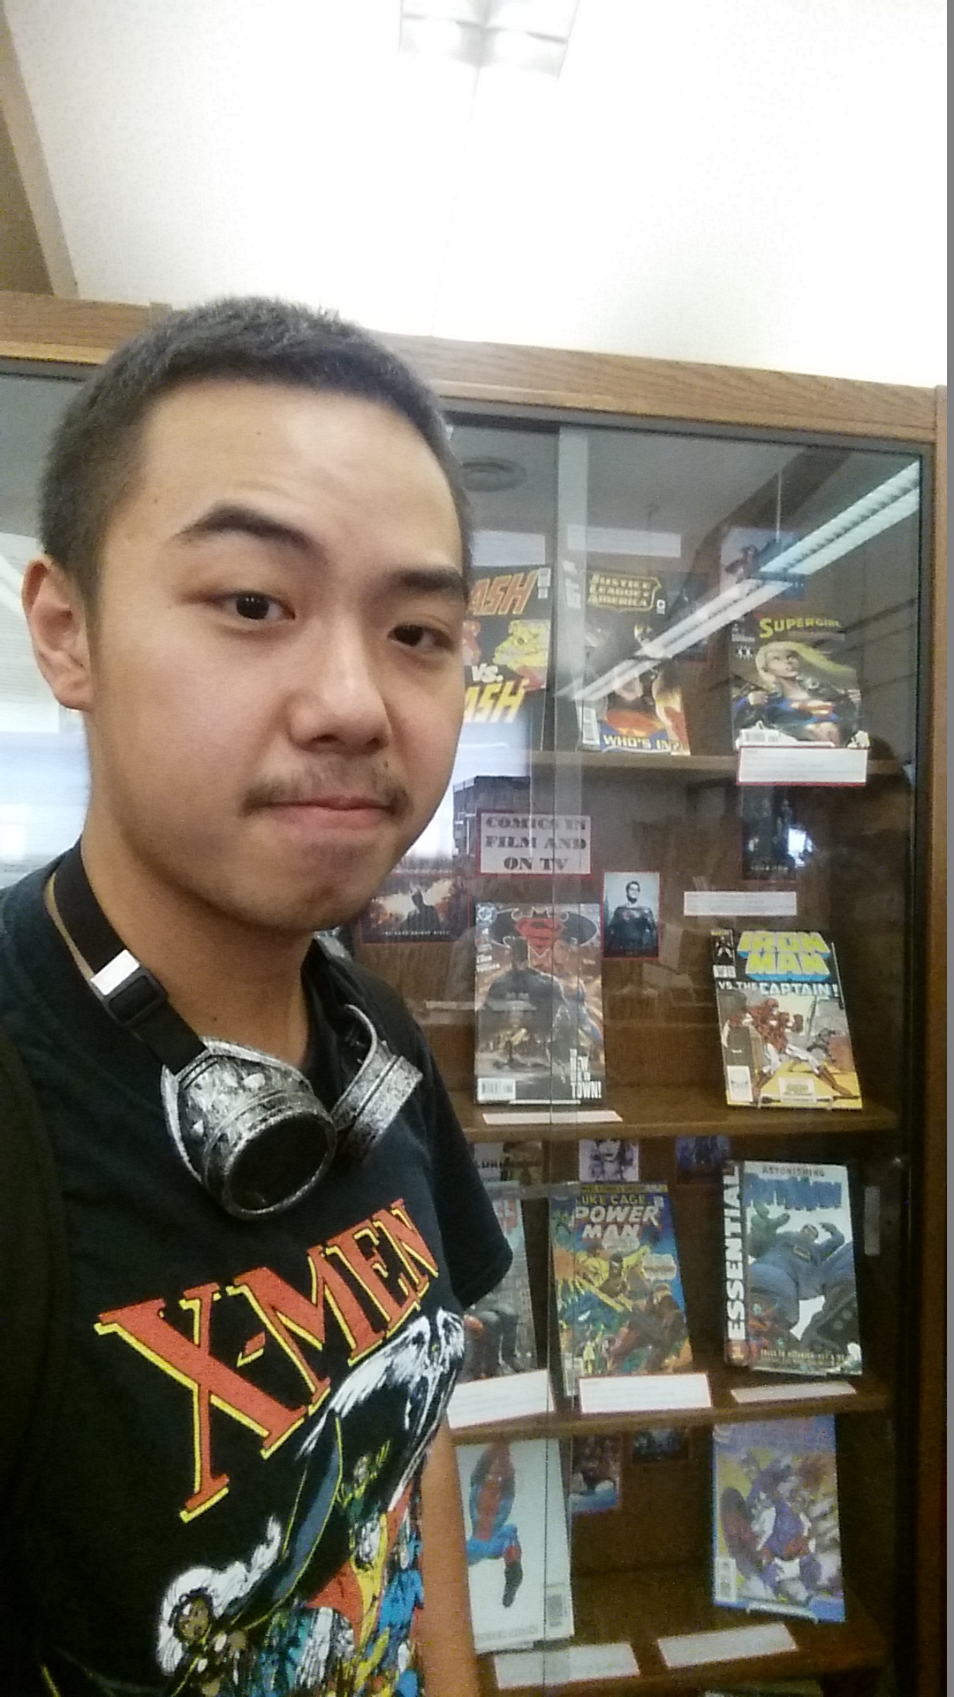
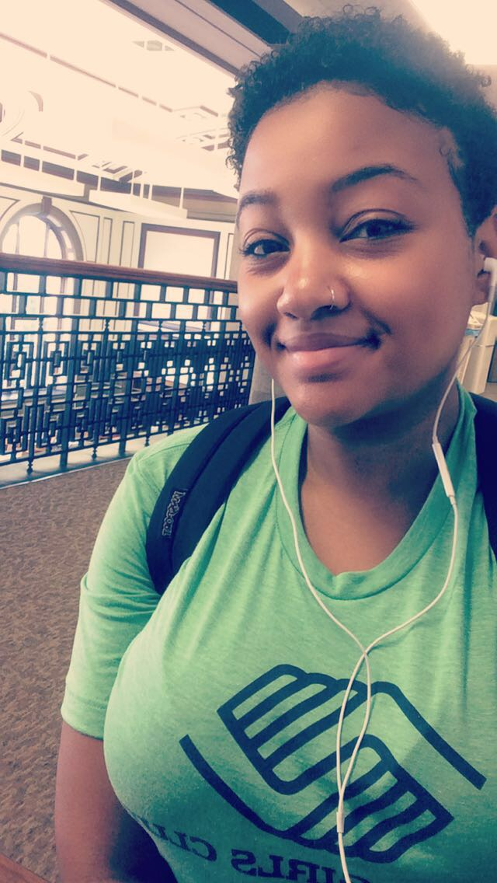
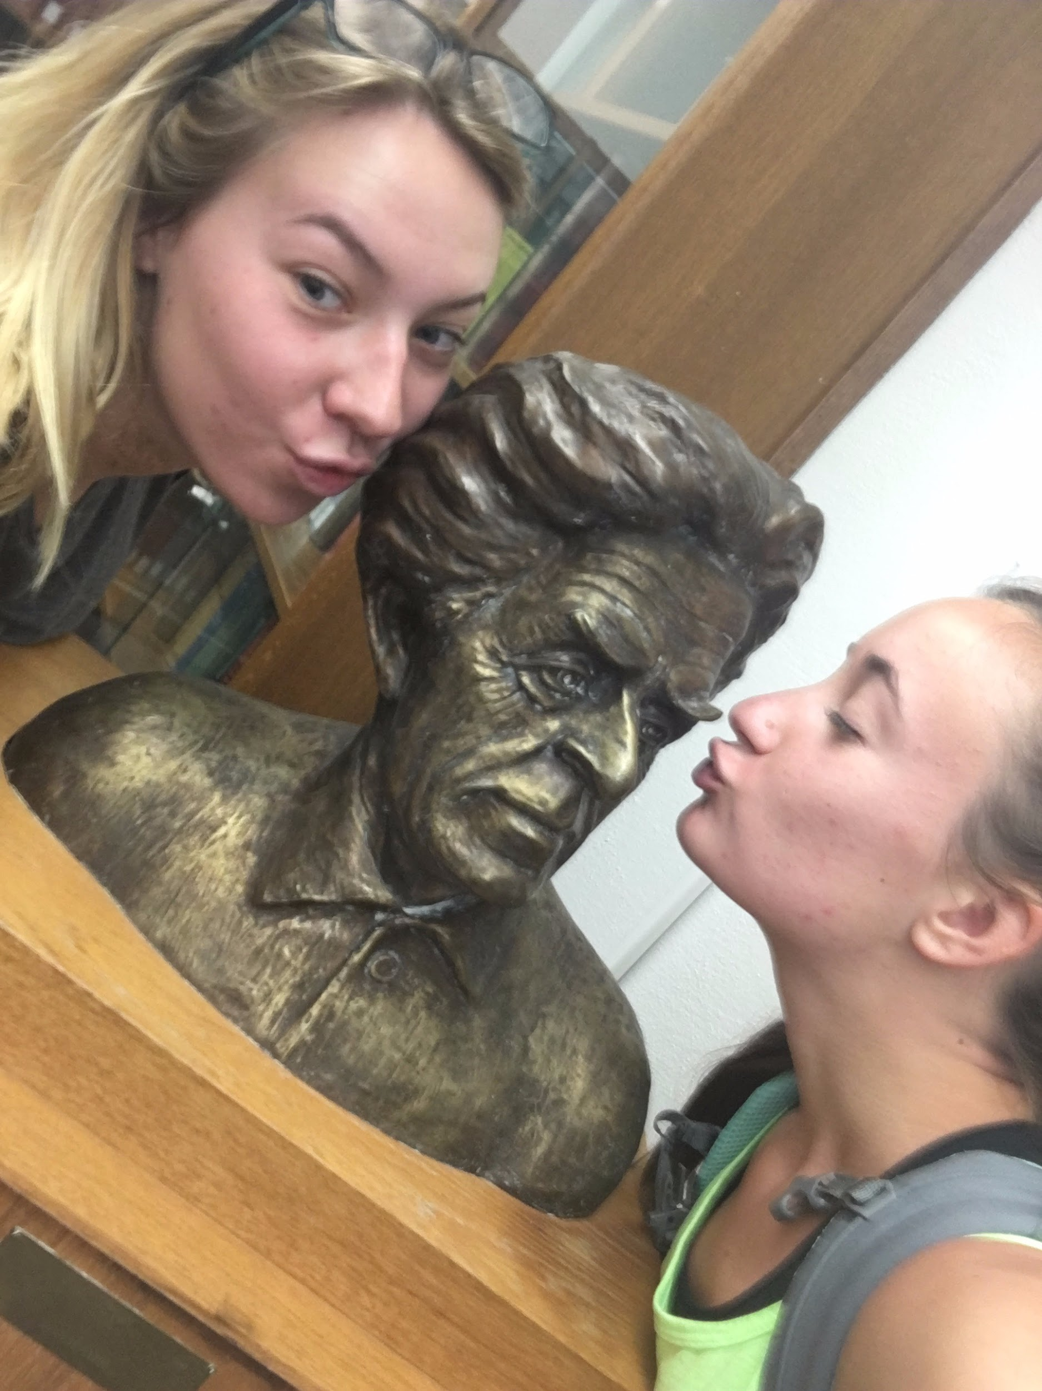
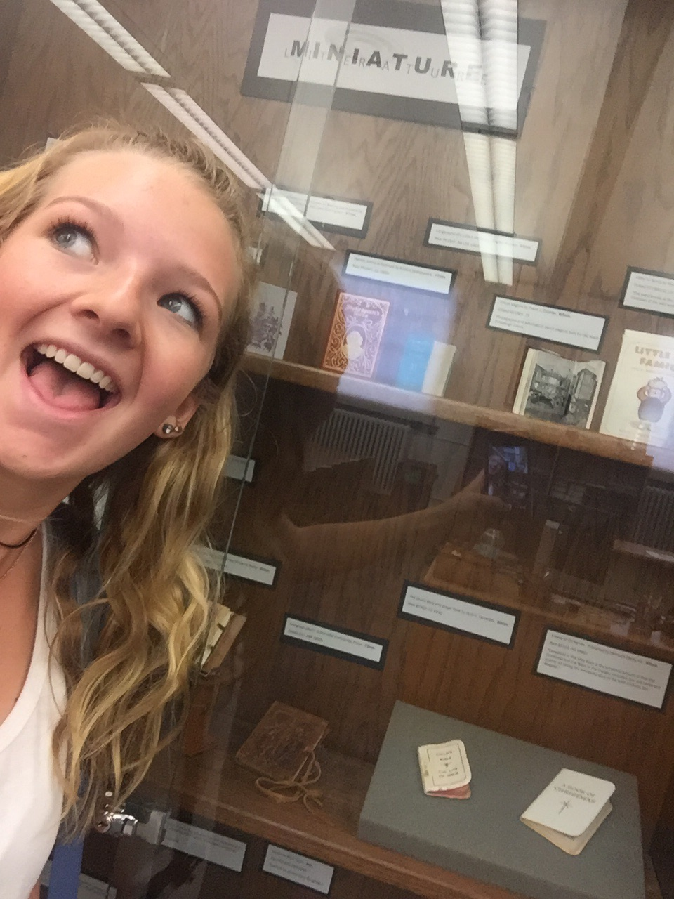
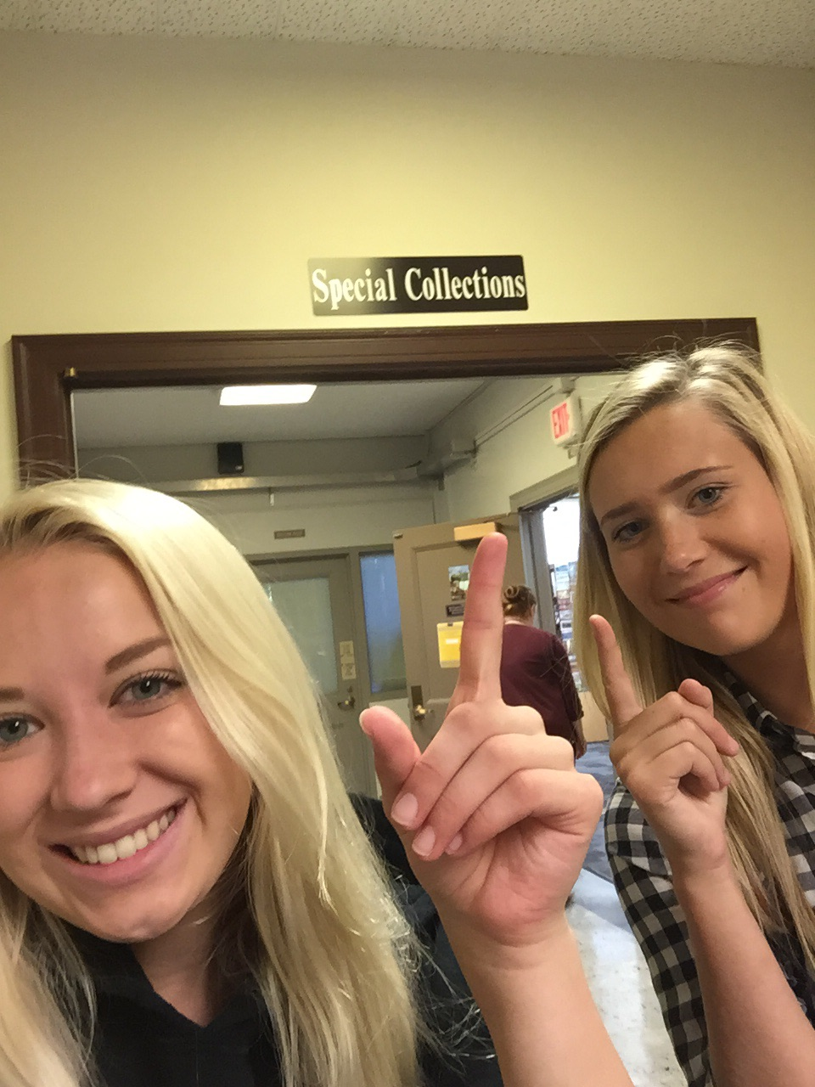
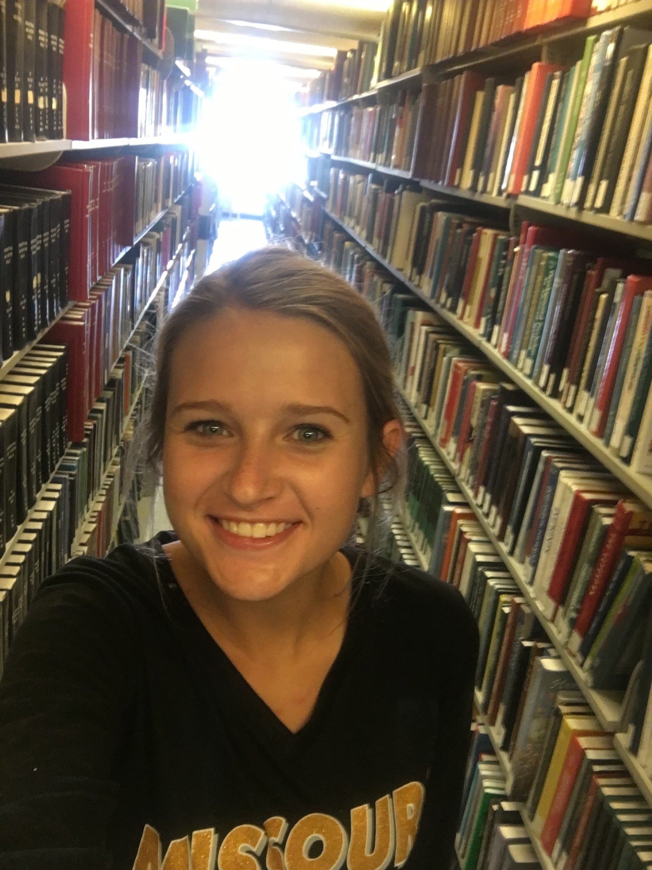
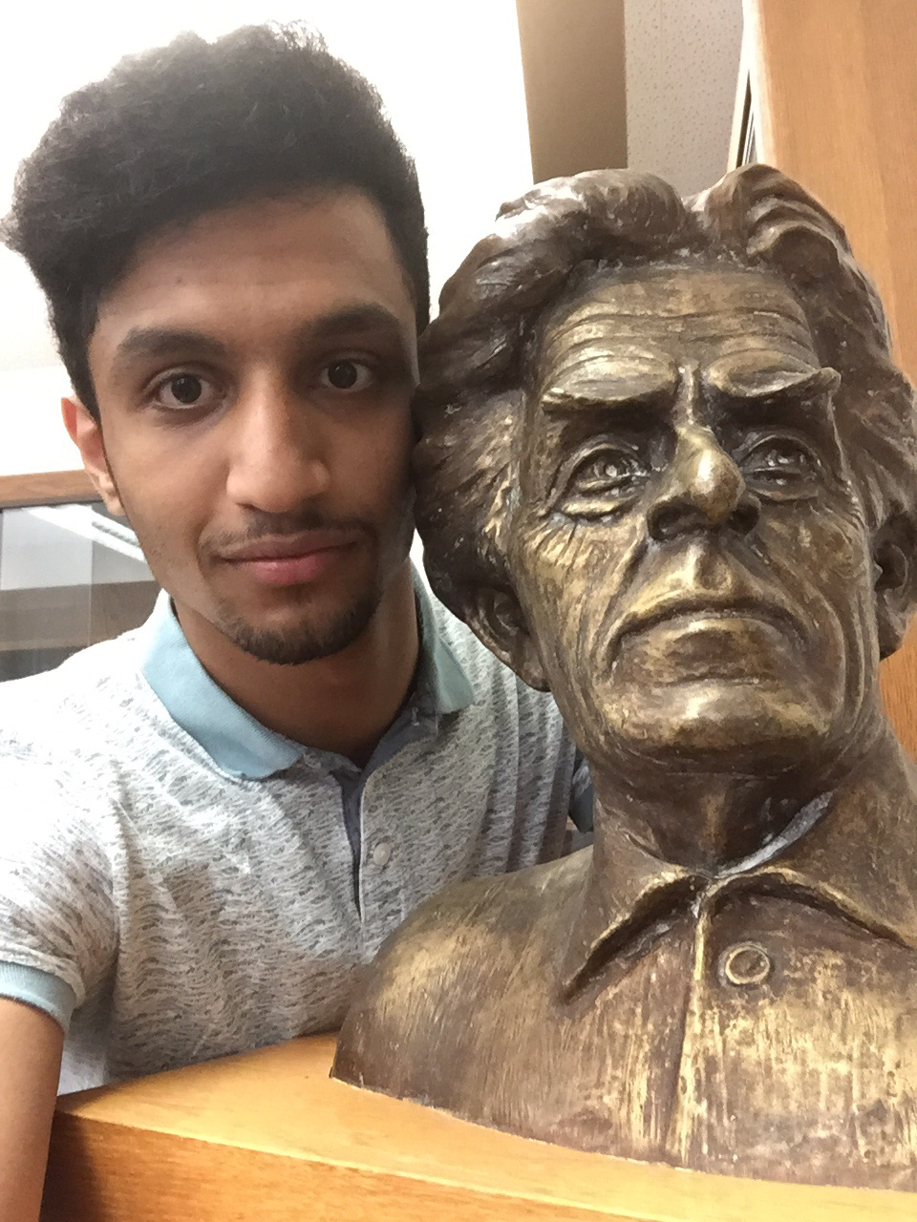
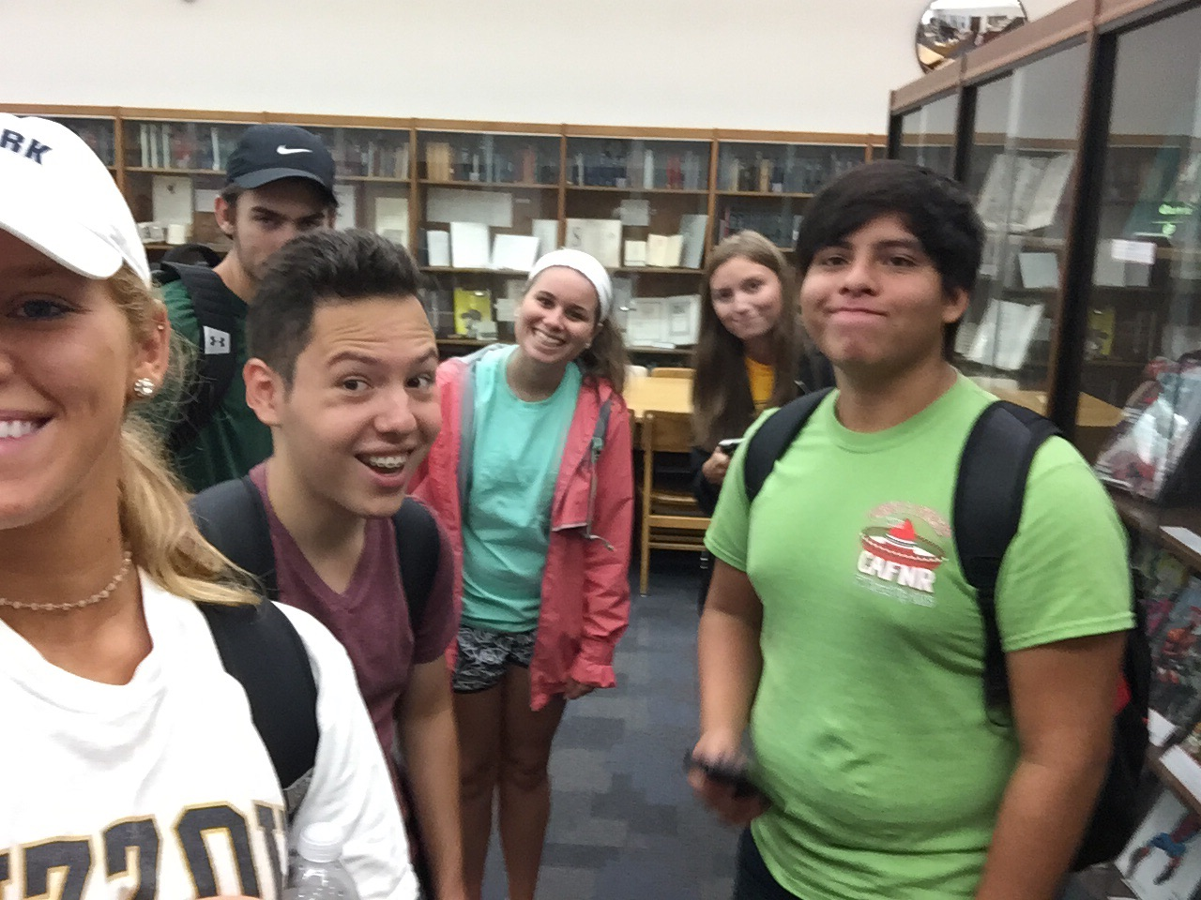
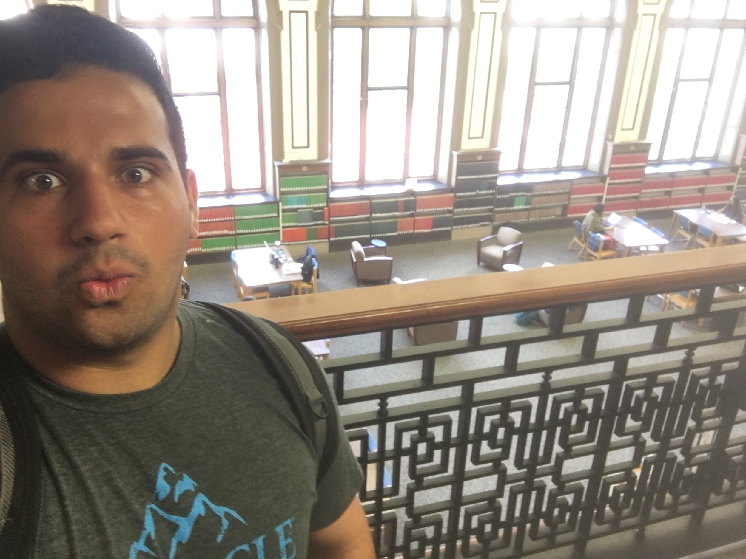
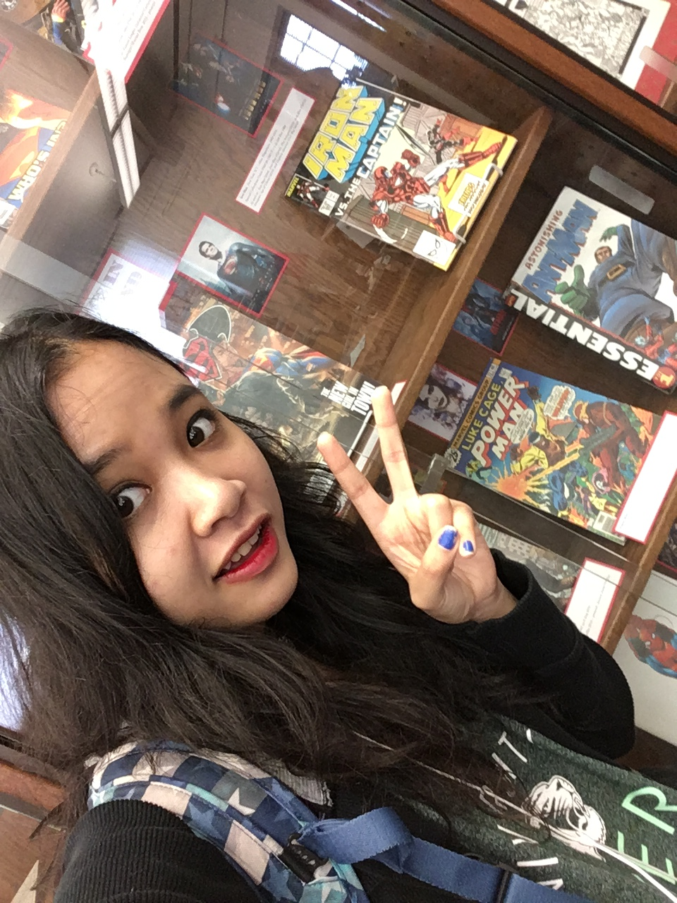
Selfies:
Notes:
Kim

Slide 14
References
Cerny, J., and Holcomb,J. (2012). "Using a QR Code Scavenger Hunt to Promote Library Services to Teens." Virginia Libraries 58 (1), 39-42.
Library Book Yields Fake Crime Photo." (1993). American Libraries (24), 119.
McCutcheon, R. (1989). Can you find it?: 25 Library scavenger hunts to sharpen your research skills. United States of America: Free Spirit.
McCutcheon, R. (1990). "Library Scavenger Hunts: A Way Out of the Bewilderness." Wilson Library Bulletin (64), 38-40.
Renner, B. R., Cahoon, E., & Allegri, F. (2016). Low-Tech Scavenger Hunt Model for Student Orientation. Medical Reference Services Quarterly, 35(4), 372-387.
Rugan, E. e., & Nero, M. m. (2013). Library Scavenger Hunts: The Good, the Bad, and the Ugly. Southeastern Librarian, 61(3), 7-10.
Notes:
Noel

