Slide 1
Digital Library Inventory
Presented by Ashley Robertson
ashleyrobertson@pb.k12.mo.us

Slide 2
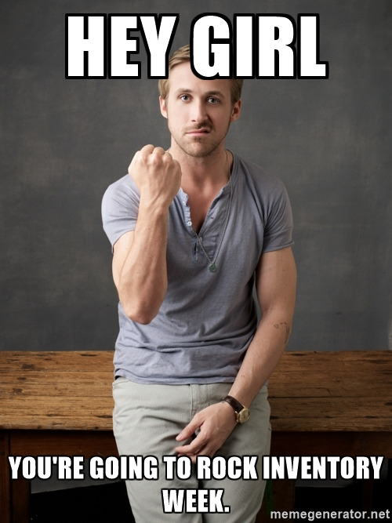

Slide 3
Why is Inventory Important?
Your collection should be always be growing and changing to meet the needs of you patrons. Inventory allows you to put your hands on your collection at least once a year.

Slide 4
How did this happen?
A staff meeting talking about inventory and spending tons of money on a device that only did one thing.
The Dreamer
Money Guy
Data Guy
Should have already retired guy
Me!! Let’s do this with a tablet and a scanner.
How much will this cost me?
How will this help us? Can you prove it with numbers?
I don’t want to learn anything new. If I don’t like it I will walk out. (But never does)

Slide 5
Things that went wrong!
We bought a Samsung tablet so we could plug in our scanners. The tablet came with a micro USB. My scanner had a regular USB. We found an adapter that worked.
Wifi was not all over the library. You need a strong connection for the remote access to work. It also has to be the same network.
Ipad app was harder to use and cost money. (Other librarians use the tablet they already had.)

Slide 6
Things that worked!
Inventory was so much faster!
Weeding Happened!
Before using the tablets we had to share a scanner with 5 schools. This created quite a problem for time. Now, all libraries could do inventory at the same time.
This type of inventory allowed us to scan the book for inventory, look at statistics, it checked in the book and we could pull the book if needed. This feature has never been available before.
We did not have to run a million reports and hunt down books. We could see everything about the book as we scanned it.

Slide 7
Wishlist
Tablet (I use a Samsung Galaxy)*
Bluetooth Scanner or adapter with scanner you are already using*
Splashtop App (Or other remote desktop app)
Wifi range in inventory area
Desktop computer with library program software
*Scanner and table were purchased at amazon.com

Slide 8
Plan
Create a proposal for your Director or Administrator
Include why this is going to save money and time for your library.
If you don’t advocate for your library no one else will!

Slide 9
Contact Information:
Ashley Robertson
ashleyrobertson@pb.k12.mo.us
573-785-3037

